Slide 1
Introducing the Wealthcare Experience

Slide 2

Simple process combining life goals and investing
Notes:
Affectionately known as “the wheel,” this is a visual representation of the comprehensive financial planning services we provide to clients. Our 360 degree approach connects a client’s life goals with their investments, ensuring the two are working in tandem to provide confidence that the client is on track for the life they desire. Just like any wheel, removing spokes compromises the wheel’s integrity and could lead to a “blow out.” If an advisor focuses solely on investing without tying the planning piece to it, one half of the wheel is missing and it can no longer turn.

Slide 3

Meet Alex and Amy
CLIENT EXAMPLE
    Both 58 years old
    One son, 19 years old
    Combined income: $395,000
    Love to travel
    Priorities:
      Reduce amount saved annually (to travel more now)
      Educate son through graduate school
      Retirement spending
      Retirement travel budget (Cayman Islands!)
    Current Assets:
      Joint
        Taxable account: $1,300,000
      Alex
        IRA $800,000
        Roth IRA $25,000
      Amy
        IRA $300,000
Note: Your age, asset size, and goals may be different. Your financial plan will be customized to fit your life.
Notes:
[Present this sample client to your prospect, while reminding them to envision their own life and goals as you walk through this sample planning example with them.]

Slide 4



Proper planning requires the proper approach
Life
Planning
Financial Planning
Investment Planning
    What’s your story?
    What are your values
    and beliefs?
    What do you want to accomplish with the rest
    of your life?
    What lifestyle do you want
    now and in the future?
    Examine current and future resources available to satisfy the needs of your life plan.
    Determine the best way to invest your current and future resources to accomplish your life plan.
    Construct a portfolio that will give you a higher probability of achieving your goals.
Notes:
I believe that proper financial planning requires three steps to be completed in the correct order. The first step is life planning. During this step, we discuss what you want your life to look like today, tomorrow, and into the future. Who’s included in that future, kids, grandkids? What’s your story? What are your goals and what do you want to accomplish? What do you value and believe?
Once we’ve developed your life plan, we move onto the financial planning step. During this step, we consider the present and future financial resources at your disposal (such as salary, business income, IRAs, 401(k)s, brokerage accounts, pensions, Social Security, inheritance, etc.) to determine what goals of your life plan are likely to be supported.
Then, and only then, do we move onto the investment step, which is simply building a portfolio that increases the likelihood of accomplishing the goals in your life plan.
A common mistake in the advising industry is skipping the first two steps and jumping right to investments. Often advisors will pitch their complex investment strategies or their investment research team as the reason why they should be hired. They might propose shifting your assets from Mutual Fund A to Mutual Fund B because they believe Mutual Fund B will outperform the market. However, this is akin to a doctor writing a prescription for a patient without diagnosing the problem first. This is malpractice and the doctor could lose her license because she didn’t do the proper examination of the client’s lifestyle and symptoms before reaching a recommendation.
The same standard should apply to financial planning. For this reason, I believe I have no right to tell a client how to invest their money until I know what they’re trying to accomplish with it.

Slide 5
The WEALTHCAREGDX® approach
Wealthcare’s goals-driven planning approach
allows you to live well AND invest well.
  Shows how to make smart tradeoffs among your different, and often competing goals and priorities
  Provides confidence in achieving your financial needs and aspirations
  Avoids undue sacrifice to your lifestyle and unnecessary investment risk
Life
Planning
Financial Planning
Investment Planning
It’s YOU-driven, not market-driven.
Notes:
I’d like to take a moment to introduce Wealthcare. I partnered with Wealthcare because it gave me access to two great support teams. The first is the planning team, and with their help, I create all the financial plans for my clients. With a team approach, there’s an exchange of ideas which results in better outputs. Furthermore, having multiple sets of eyes reviewing all plans helps catch errors.
The second is the trading team, and with their help, I’m able to promise that all my clients’ portfolios are reviewed at least once daily (on days when the market is open) to see if any trades need to be executed. However, this doesn’t mean we trade daily. We’re not market timers or day traders, but we want to review everyone’s portfolios to ensure they are within thresholds for the selected investment strategy.

Slide 6
Goals are not data points
Think of each goal as a range between Ideal and Acceptable.
Ideal represents your greatest aspiration. Acceptable, a lesser but still satisfying result.
 | Ideal | Acceptable
Retirement Age Goal: | Both Retire Now | Both Retire at 65
Retirement Spending Goal: | $175,000 | $160,000
Risk Tolerance Goal: | -5% Annual Downside | -14% Annual Downside
Estate Goal: | $2,000,000 | $100,000
Annual Saving Goal: | Reduce by $10,000 | Increase by $15,000
Education for Son: | MBA | Undergraduate
Cayman Islands Travel: | $25,000 | $10,000
Notes:
The first step in creating a financial plan is establishing two thresholds for every goal. The first threshold is the ideal threshold, which is meant to be aspirational. Let’s pretend the market magically went up every year, what would you do? What would your life be like? What would you accomplish? The second is the acceptable threshold, and this is the opposite end of the spectrum. Let’s pretend we’re mired in the Great Depression and your neighbors are in line at the soup kitchen, we still want you to be happy and live a nice life, be we’d need to tamp down your goals and lifestyle to acknowledge the markets aren’t working in our favor.
I’ll give you some examples. Alex and Amy would ideally retire now at age 58 but are willing to work until 65 if it means they’re able to accomplish some of their other goals they deem more important. They’d really like to spend $175,000/year after taxes in retirement but are willing to spend as little as $160,000. In a perfect world, Alex and Amy would leave their son $2 million when they pass away, but if they needed to spend down their assets to support their retirement, leaving him as little as $100,000 would be acceptable. Ideally, they’d fund their son’s education through grad school, but if they could only cover undergrad that would be OK. I think you get the idea so I won’t belabor the point, but we want to establish guardrails for each goal.

Slide 7
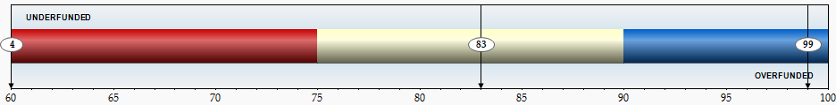

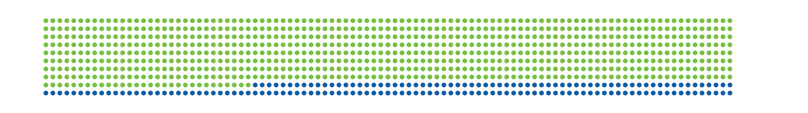
How does stress testing work?
Central to our goals-based approach is the Comfort Zone® confidence calculation
This analysis simultaneously evaluates your goals, your investment allocation, and your assets to determine how confident you can be that you will exceed your goals.
Wealthcare’s approach subjects your goals and investments strategy to a sophisticated “stress testing” process which simulates 1,000 market environments, both good and bad. Your confidence (comfort) is the percentage of the 1,000 simulations that exceed your goals.
For example, if you exceeded your goals in 830 of 1,000 tests, your confidence level is 83%. Said another way, there would be an 83% probability that the goals of your financial plan would not only be met, but would be exceeded.
Notes:
Another mistake made by much of the advising industry is focusing on the past. I’ll give you an example. When you open your statement, you’ll see past performance numbers for month to date, quarter to date, year to date, etc. It may say you’re up 7% or down 3%, or maybe your accounts gained $10,000 or lost $5,000. While this information may be interesting, it’s in the past, cannot be changed, and it tells you nothing about your ability to live the life you want today and into the future. In this case, the advisor isn’t acting as an advisor, he’s acting as a reporter. Reporters document and explain what happened. Advisors should look to the future and attempt to provide valuable advice to navigate that future.
You know when your accounts increase in value it’s good and when they drop it’s bad, but this tells you nothing about your ability to accomplish your future goals. Can you still retire at age 60 like you hoped? Can you afford to put your kids through college? These questions are not mentioned or answered in the typical advisor’s report. My job is to serve as the bridge between what’s happening in the market and your portfolio and explaining what it means for your future goals. My job is to look forward.
Because we don’t have a crystal ball that tells us what will happen in the market, we use a process called “stress testing.” We create 1,000 different tests or scenarios of how the market could play out from today through the end of your life. On one end of the spectrum, we have scenarios with returns worse than anything we’ve seen in history. On the other end, we have scenarios with returns better than anything we’ve seen in history. This is to acknowledge that the market is capable of doing something we’ve never seen before. In between, we have hundreds of other scenarios with good returns followed by bad, in different orders, in different degrees of severity, trying to simulate the many ways the market could play out from now through the end of your life.
We run your goals through the 1,000 tests and count how many times you either met or exceeded your goals. Say you exceeded your goals in 830 of the 1,000 tests. In this case, your confidence level is 83%. Said another way, there would be an 83% probability that the goals of your financial plan would not only be met, but would be exceeded. Instead of reporting past performance that tells you nothing about the future, we report the likelihood that you’re on track to live the life you want.

Slide 8
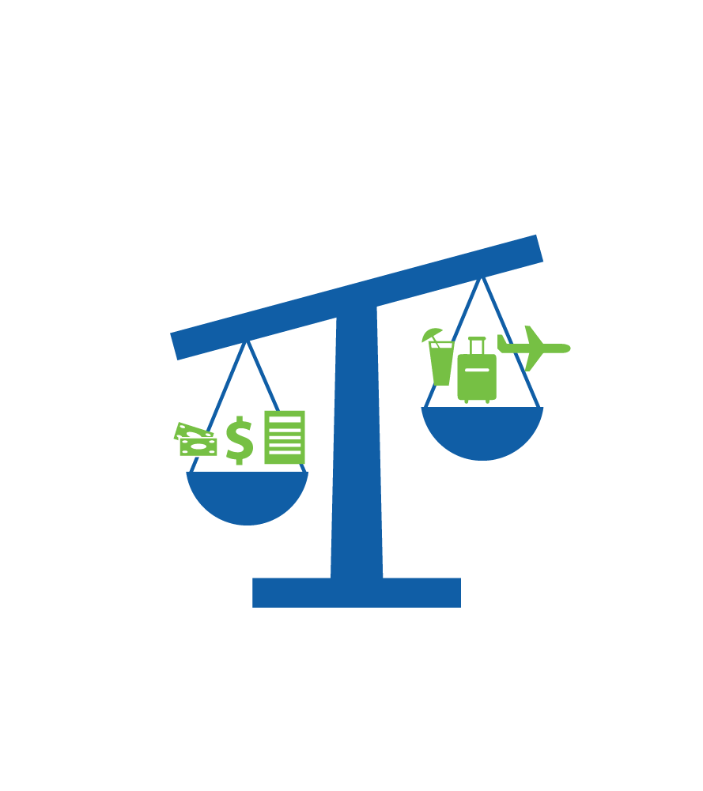
Stress testing for sacrifice
Overfunded > 90%...Sacrifice
You are needlessly sacrificing your lifestyle. You could take less investment risk, achieve larger or more goals sooner and still maintain confidence in your financial future.
Notes:
Sometimes clients will say, “I only want a plan with 100% confidence.” I understand where they’re coming from, but this is actually undesirable. One, there is no such thing as 100% confidence no matter what any planning system says, because there are no guarantees in life. Two, such a high confidence level would mean sacrificing your quality of life today and into the future. Remember how I mentioned that we have scenarios that are worse than anything we’ve ever seen before in the markets? While these scenarios are possible, it doesn’t mean they are probable or likely. I don’t want my clients living their lives planning for some sort of disaster that may not occur. If it does, we’ll adjust for it, but in the meantime, I don’t want you sacrificing your quality of living. For this reason if a client had a confidence level over 90%, it means they could be doing something more: retiring sooner, saving less to spend more today, taking less investment risk, or spending more in retirement.

Slide 9
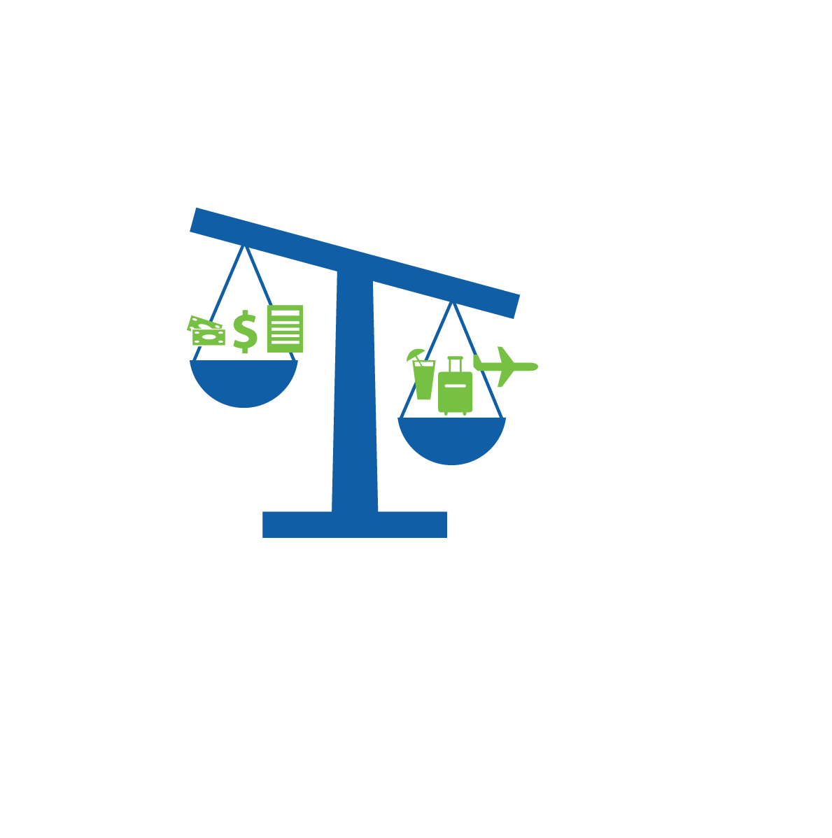
Stress testing for uncertainty
Underfunded < 75%...Uncertain
There is too high of a chance you may not exceed your goals. Adjustments need to be made.
Notes:
If you have a confidence level below 75%, it means you are in the uncertain zone. We are trained from a young age that red signals danger, but in this case it’s not that scary. It simply means adjustments are needed to your plan in order to increase your odds. Options include working longer, saving more, taking more risk in the hope of higher future returns, spending less in retirement, or leaving less behind to your heirs. The rationale behind this is that we want everyone to have at least a three out of four chance of living the life they want.

Slide 10
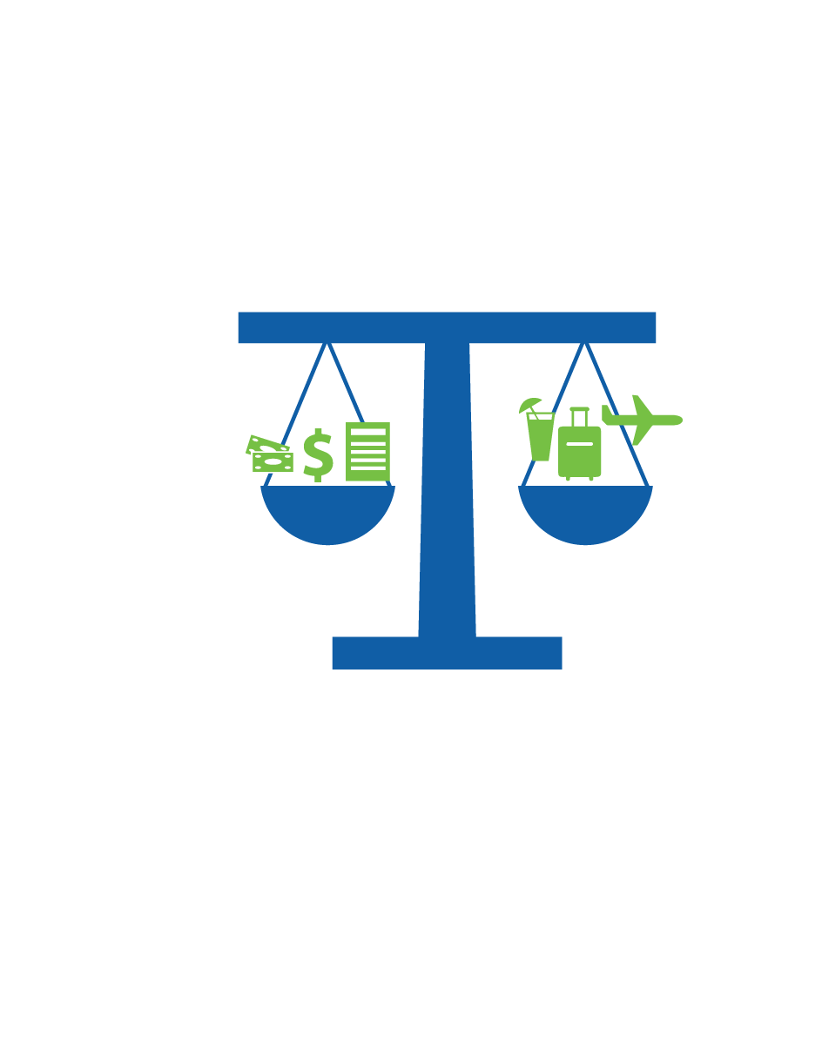
Stress testing to find balance
Confidence and Comfort in Balance - Funded
A confidence level between 75% and 90% should give you confidence that you can exceed your goals. This reading indicates a set of goals that is manageable and avoids unnecessary investment risk and/or sacrifice.
Notes:
That leaves us with what we call the Comfort Zone, between 75% and 90% confidence. We believe this is a solid balance because it avoids being too conservative with a confidence level over 90% as well as being too aggressive with less than a three out of four chance of living the life you want. My job is to get my client’s financial plans into the Comfort Zone and help them monitor them so they stay there.

Slide 11

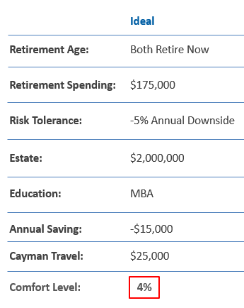
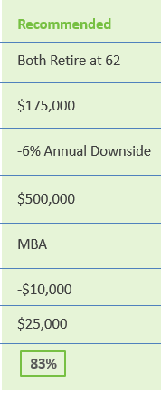
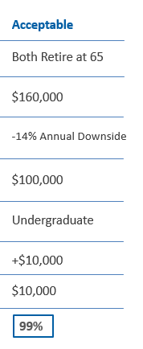
Sample client recommendation
Notes:
Let’s apply this framework to our sample clients, Alex and Amy. When running their ideal set of goals through the stress testing process, there is currently a 4% likelihood this plan would work. While the ideal is clearly not a feasible plan, this is quite normal. The ideal is meant to be aspirational in nature, so single digit percentages (or even zero percent) are common.
On the other hand, the acceptable set of goals currently has a 99% confidence level. With a confidence score in that sacrifice zone above 90%, this is not a feasible starting point either. The good news is that the client has a plan that currently has a high likelihood of working out to fall back upon if the markets took a hit.
At this point, the client and I work together to develop a plan that focuses on accomplishing the goals they define as most important while compromising the goals they feel are least important. For example, ideally they both wanted to retire now at age 58 but were willing to work until age 65. For right now, I’m currently recommending they plan on working until age 62. From this, you can glean that this goal is important to them, but is likely not the most important goal. They were willing to compromise this goal from their ideal in order to achieve other goals they deemed more important.
Such as their retirement spending goal. They really wanted to be able to spend $175,000/year after taxes in retirement. For this reason, I’m recommending they plan on spending that amount.
We previously discussed their desire to leave money to their son once they pass away. For now, let’s plan on leaving him $500,000. You can tell this is a relatively less-important goal to Alex and Amy, as it’s much closer to their acceptable value than their ideal value.
However, by compromising the estate goal, it allowed them to accomplish another one of their most important goals: funding their son’s education through grad school.
When you put this recommended goal set through the stress test engine, it currently has an 83% confidence level, which is firmly within the Comfort Zone, so this would be a good starting point for Alex and Amy.

Slide 12
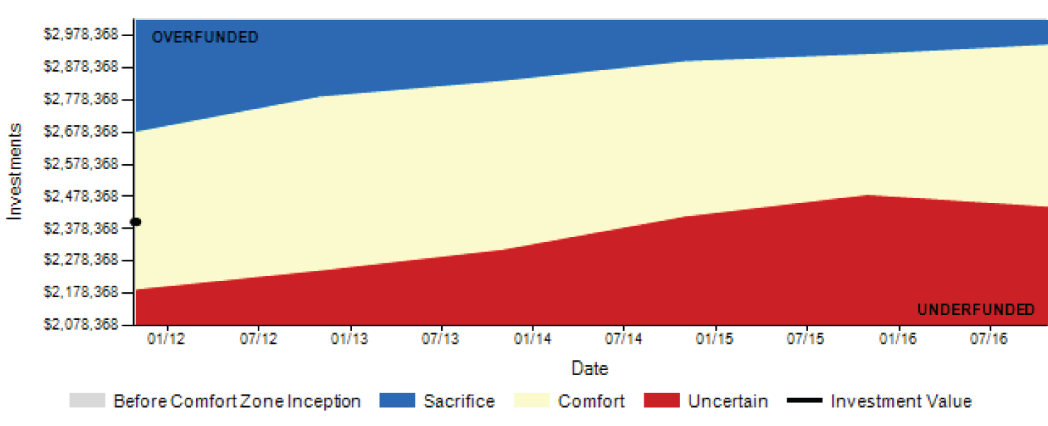
Monitoring progress toward goals
Wealthcare’s GDX360® Status Reports can be automatically generated every quarter.
Your plan dynamically links your lifestyle goals with your investments.
You are free from uncertainty about what to do when confronted by change, expected or otherwise.
COMFORT ZONE (SHORT TERM)
Your Wealthcare plan will evolve as your life does, proactively adapting to life’s changes along with you.
Notes:
On the previous page, you may have noticed me saying things like, “For right now, let’s plan on…,” or “I currently recommend…” The reason why I used this phrasing is because each time a stress test is run, it’s just a snapshot in time. The only thing we know with certainty is that things will change. The markets will change. They will go up and down. We as people change. Our lifestyle, hobbies, spending habits, and interests change over time. When you first retire, you may still have your health and be quite active. You might travel quite a bit or spend time golfing. As you age, you start to slow down. You might not have any major health issues, but at some point, you stop climbing mountains and instead spend time sitting in front of a fire while petting the cat and reading a book.
For this reason, we cannot just run your plan once, obtain a satisfactory confidence score, and assume you’re set for life. We continuously monitor your plan to ensure you’re staying on track to live the life you want. [IF APPLICABLE TO THE ADVISOR] We review our clients’ plans on a monthly basis and issue reports at least quarterly, so you’ll receive ongoing updates on your plan.

Slide 13
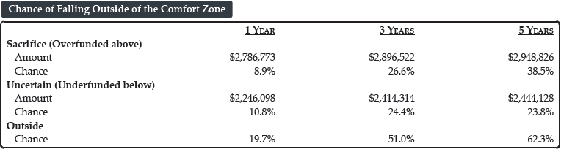
Knowing what to do…and when
The Comfort Zone® acts as an “early warning system” notifying you if you need to make adjustments
COMFORT ZONE (SHORT TERM)
Notes:
The Comfort Zone also acts as an early warning system. Looking at the tricolor chart, the X axis is time, moving from left to right. The Y axis is the client’s total household portfolio value. As time progresses, we’ll chart the course your plan is taking. The red area represents the uncertain zone below 75% confidence, and the blue area represents the sacrifice zone over 90% confidence, so the goal is to keep your plan within the yellow Comfort Zone.
Let’s say the market dropped and your plan fell into the red area. That’s when I’d call you and say something like, “I’m sure you’ve seen on the news, the market hasn’t been treating us well, so your plan is currently below 75% confidence. What adjustment would you prefer? Working an extra couple years? Saving $10,000 more per year for the next decade? Increasing the risk in your portfolio in the hope that it achieves greater returns in the future? Maybe you’re willing to spend $5,000 less per year in retirement or leave less to the kids when you’re gone?” Let’s say you elect to work a couple extra years. We’d adjust your plan accordingly, and your plan pops back up into the Comfort Zone.
Let’s say the market is up and your plan has drifted into the blue sacrifice zone above 90% confidence. This is a much more fun phone call. I’d call you and say something like, “The market has been good to us and your plan is ahead of schedule. What adjustment would you prefer? Retiring sooner than expected? Deceasing the amount you’re saving so you can take an annual family vacation? Decreasing the risk in your portfolio to take some of your winnings off the table? Spend more in retirement? Or leave more money to the kids when you’re gone?” Let’s say you decide to reduce your portfolio risk. We’d adjust your plan accordingly and your plan drops down into the Comfort Zone.
The takeaway is that it’s easier to proactively make small adjustments along the way than to ignore the plan, be blown way off course, and needing to make drastic measures to get back on track.
We can even estimate the likelihood you’ll drift outside the Comfort Zone if we set the plan on autopilot and ceased to monitor it. Let’s look at the bottom chart for Alex and Amy. We have three columns: one year from today, three years from today, and five years from today. It’s showing there’s currently an 8.9% chance that Alex and Amy will be in the blue sacrifice zone one year from today. There’s also a 10.8% chance they’ll be in the red uncertain zone one year from today. 8.9% + 10.8% totals to 19.7%, meaning there’s a 19.7% chance they’ll be outside the Comfort Zone, one way or the other, one year from today.
If we continued to not monitor the plan, this probability jumps to 51% in three years and 62.3% in five years. The key point is there’s a high likelihood your plan will eventually drift outside the Comfort Zone, and we won’t know when and how to adjust for it unless we proactively monitor it.

Slide 14
Simple process combining life goals and investing
Notes:
Now that we’ve discussed the top half of our services wheel in regards to our planning approach, we’ll move onto the bottom half of the wheel that addresses how we strive to add value in regards to investing.

Slide 15
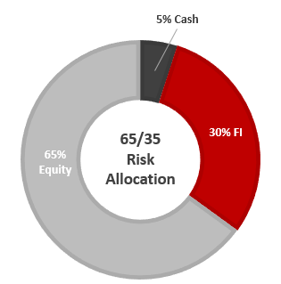
Traditional account based portfolio management
Typical scenario: advisor sets an investment allocation based on a series of risk profile answers.
“My goal for this investment is to grow (aggressively, moderately or cautiously).
“My income sources are _________ (stable/unstable).”
“I plan to start taking money from my investments in _____ years.”
    Current Assets (4 accounts):
      JOINT: Taxable Acct $1,300,000
      ALEX: IRA $800,000
        Roth IRA $25,000
      AMY: IRA $300,000
Notes:
The traditional approach to portfolio management uses a risk tolerance questionnaire to estimate a client’s maximum appetite for risk. Little to no consideration is given to the client’s goals or the life they want today and into the future, and the client’s portfolio is automatically invested at their maximum risk level.
For simplicity, or often out of lack of scope, the advisor will then invest each client account in the exact same manner; each account holding the exact same funds in the exact same ratios. In this example, the client’s maximum risk tolerance was a 65% equity portfolio, so the advisor invested all four of the client’s accounts in the same 65% equity / 35% fixed income allocation, regardless of the tax treatment associated with each account.

Slide 16
Pitfalls of account-based portfolio management
    Account-based shortcomings:
      Costs
          Larger number of holdings at inception
          (4 x 12= 48 transactions)
          More positions equals more costs
      Taxes
          Putting tax inefficient holdings in taxable accounts
            Treasuries, REITs, High Yield FI, Commodities, belong in Tax- Deferred accounts
  Rebalancing
      Each account rebalanced separately
        Greatly increases transaction costs
      Rebalancing in taxable account creates
      a tax consequence
48 Total Holdings
Joint
12 Funds
12 Funds
12 Funds
Treasuries, Commodities, REITS, High Yield
12 Funds
Notes:
There are three main issues with this type of investment approach:
Because every account must hold all of the exact same funds, more transaction fees are incurred to implement the portfolio. For example, if the portfolio strategy used 12 different funds and the client had four accounts, this would call for 48 buy orders.
Account-based portfolio management places a portion of the least tax-efficient assets (namely those generating income taxed at higher rates, such as bonds, commodities, and REITs) in taxable accounts. As a result, the income produced by these holdings flows to the client’s tax return in the current year and is taxed at those unfavorable rates.
Whenever the portfolio requires rebalancing, EVERY account requires trades because they are all outside of the pre-established thresholds by the same amount. This is another source of increased transaction fees. In addition, the rebalancing required in any taxable account will create some sort of tax consequence.

Slide 17
Controlling the controllable
Wealthcare invests differently
Two guiding principles drive our investment philosophy:
  Cost Effective: Managing cost through Household-Based Portfolio Management
  Goals Connected: Managing your investing behavior & goals
  through Comfort Zone monitoring
For over a decade, we have helped investors pursue and strive to achieve their goals using a dynamic and disciplined approach that seamlessly integrates your financial plan with your investments.
Notes:
How we invest differently at Wealthcare boils down to one concept: control the controllable. We have significant control over portfolio fees. Therefore, we use cost-effective funds with relatively low expense ratios. We use a household-based portfolio management approach to greatly reduce the number of trades needed to initially invest and later rebalance a client’s portfolio. I’ll show you examples of this a little later.
While no one can control the market, there are several financial planning aspects the client and advisor can control to a degree: when the client retires, how much the client spends, how much the client saves, how much risk the client takes in his/her portfolio, and how much the client plans on leaving behind to heirs. Instead of focusing the majority of our time on the one aspect we can’t control (i.e. the market), we spend a great deal of time ensuring the client is on track to live the life they want by focusing on the things we can control.

Slide 18

Non-traditional advisor alpha– Morningstar¹ gamma
.
APPROACH | VALUE ADDED (BPS)
Total Wealth Framework | 38
Dynamic Withdrawals | 54
Asset Location/Withdrawal Sourcing | 52
Total | 144
¹Blanchett, Kaplan. August 2013. “Alpha, Beta and Now…Gamma” Journal of Retirement.
Notes:
Morningstar conducted a study that identified three ways an advisor can add value that are not market dependent. That means a proactive advisor is able to provide value when the market is either up or down. While this study wasn’t conducted specifically on the Wealthcare process, we use similar tactics in managing our clients’ portfolios.
Using a total wealth framework refers to a client’s ability to assume risk based on their total wealth, which is not just their current investment assets but also their future potential ability to save. This is different than investing a client’s portfolio solely on their risk preference (i.e. a risk tolerance questionnaire).
Many financial plans assume some sort of static withdrawal rate. A common example is the “4% Rule,” where the client would withdraw 4% of their initial portfolio in their first year of retirement and continue withdrawing that amount each year, adjusted for inflation. A dynamic withdrawal strategy allows for the reality that the client will take more or less in a given year based on ever-changing portfolio size and life expectancy.
Asset location generally refers to placing less tax-efficient assets in tax-deferred accounts (e.g. 401k or traditional IRA), where their gains do not automatically hit the client’s tax return in the year earned, while placing more tax-efficient assets in taxable accounts. Withdrawal sourcing refers to the generally favorable practice of withdrawing funds from taxable accounts before withdrawing money from tax-advantaged accounts.

Slide 19
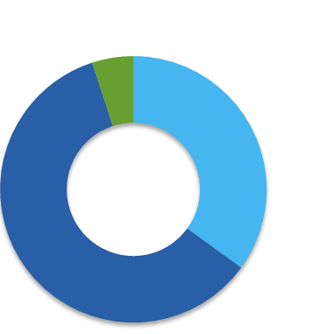
Managing portfolios at the household level
5% Cash
    Efficient Portfolio Construction
    Asset location tax management strategies
    Household-based rebalancing
    Smart withdrawal sourcing
    Other tax management services
30% FI
$1.3M
$800k
$25k
65/35
Plan
Allocation
$300k
65% Equity
Notes:
Our household-based portfolio management strategy incorporates the same concepts from the Morningstar study.

Slide 20
Asset location — tax management strategies
5% Cash
        Place high turnover holdings in
        tax-deferred/exempt accounts FIRST
        to maximize after-tax wealth
        Put low turnover holdings in taxable accounts FIRST to take advantage of more favorable long-term capital gains rates
        Place high-yielding holdings in
        tax-deferred accounts
        Put muni bonds in taxable accounts and taxable bonds in tax-deferred accounts
65/35
Plan
Allocation
30% FI
65% Equity
Active Equities, Treasuries, REITs, Commodities
Passive Equities, Muni Bonds
IRA
IRA
Joint
100% Equities
Roth
Notes:
To improve tax efficiency, the least tax-efficient assets (namely those generating income taxed at higher rates, such as bonds, commodities, and REITs) should be housed in tax-deferred accounts to keep their gains off the client’s tax return in the present. The same treatment should be applied to high-turnover holdings to keep their associated realized gains tax-deferred. Investments with the most risk/upside should be held in Roth accounts, so if they experience higher growth, all associated gains will be tax free. Taxable accounts are a great place to house equities because qualified dividends and long-term capital gains are taxed at favorable capital gain rates that are unavailable to assets housed in tax-deferred accounts.
Such an approach typically yields a different investment allocation and different holdings in each client account, but when all accounts are combined, it results in the client’s targeted investment allocation, in this case 65% equities / 35% fixed income.

Slide 21
Household-based trading & rebalancing
5% Cash
        Fewer positions at inception; lower trading costs
        Use a single tax-deferred/exempt account to rebalance entire portfolio
        Rebalance using fewer positions, resulting in fewer trades & lower costs
        Minimize tax impact of rebalancing by not using a taxable account
65/35
Plan
Allocation
30% FI
65% Equity
Infrequent rebalancing minimizes tax consequence
Primary rebalancing account
12
Funds
6
Funds
Half the funds & half the transaction costs
IRA
Joint
2 Funds
4 Funds
IRA
Notes:
Our household-based approach means fewer trades placed to initially implement the investment strategy, which means fewer transactions fees. Because each account doesn’t need to hold all of the same funds, just a fraction of the trades are placed. In our example, instead of each account holding the same 12 funds, triggering 48 trades, we achieve the 65/35 allocation with just 24 trades, cutting trading costs in half.
The same benefit occurs when rebalancing the portfolio. Instead of needing to trade every account to get back to target, we are often able to rebalance a portfolio by trading just one account. Here, our primary rebalancing account is the client’s IRA. If the client’s household were overweight to domestic equities and underweight to bonds, just two trades placed in this account could return the client’s portfolio to target. This is much preferable to trading all four accounts, resulting in eight trades. Furthermore, by trading just the IRA, no trades are placed in the taxable account, avoiding any potential taxable realized gains.

Slide 22
Smart withdrawal strategies
        Sample $145K withdrawal. Done in a tax-efficient manner based on the assets and circumstances of each individual household.
 |  |  |  |  |  | Typical |  | Wealthcare
Household |  |  | MV($) | % | Unrealized Gains | Trades | Tax Effect ($) | Trades | Tax Effect ($)
Domestic Equity (VTI) |  |  | 1,355,575 | 56%
International Equity (VEU) |  |  | 220,675 | 9%
Fixed Income (IEF) |  |  | 800,250 | 33%
Cash |  |  | 48,500 | 2%
 |  |  | 2,425,000 | 100%
Tax Deferred (IRAs)
Domestic Equity (VTI) |  |  | 246,907 |  |  |  |  | (72,500)
International Equity (VEU) |  |  | 220,675
Fixed Income (IEF) |  |  | 609,513 |  |  |  |  | 72,500
Cash |  |  | 22,906
Tax Exempt (Roth)
Domestic Equity (VTI) |  |  | 25,000
Taxable Account
Domestic Equity (VTI) |  |  | 1,083,668 |  | 671,874 | (72,500) | (8,990) |  | 0
International Equity (VEU) |  |  | 0 |  | 0
Fixed Income (MUB) |  |  | 190,737 |  | 15,137 | (72,500) | (1,151) | (145,000) | (2,301)
Cash |  |  | 25,594 |  | 0
 |  |  |  |  |  |  | (10,141)¹ |  | (2,301)¹
 |  |  |  |  |  |  | -0.42% |  | -0.09%
        ¹Note: tax effect calculated by applying 20% tax rate on realized gains
Notes:
Using a smart withdrawal strategy in tandem with our our household-based approach can result in better tax outcomes. Let’s say a client wished to withdraw $145,000 from their portfolio to buy a cottage. The plan is to withdraw half ($72,500) from domestic equities and the other half from bonds, and the full $145,000 will come from the taxable account to take advantage of favorable capital gain tax rates and to avoid an IRA distribution that would be 100% taxable at ordinary tax rates.
The typical, straightforward approach would have the client sell both domestic equities and bonds in the taxable account to raise the necessary cash. In the example, this results in taxable realized gains and a $10,141 tax bill for the client. Using a smart withdrawal strategy, we’d sell $145,000 of the bond position in the taxable account to generate the cash while realizing the least amount of taxable gains possible. To offset this and follow the plan of taking half the withdrawal from domestic equities, we’d sell $72,500 of the domestic equity position in the IRA and shift it to bonds. Such trades net the same end result as the typical approach, but the client incurs a tax burden of only $2,301, a savings of $7,840.

Slide 23
Other tax management strategies
5% Cash
        Monitor timing of when unrealized gains or losses change from short-term to long-term
        Tax-loss harvesting services
        Consider unrealized status of positions and carry forward losses prior to trading of taxable accounts
65/35
Plan
Allocation
30% FI
65% Equity
Recognize Unrealized Losses
Gain
-$3k
Joint
Gain
Gain
Notes:
Rather than relying on an automated trading algorithm, Wealthcare’s living, breathing trading team uses judgement and logic to employ additional tax management strategies. For example, they may wait a day to trade an account if they notice the position to be sold will change from short-term to long-term the next day. They’ll look to sell holdings with unrealized losses in taxable accounts to offset realized gains already incurred that year. Or, if there are no gains to offset, these harvested losses become a balance sheet asset available to offset future gains.

Slide 24
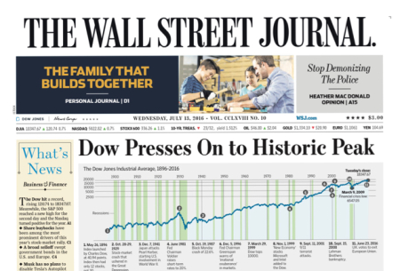
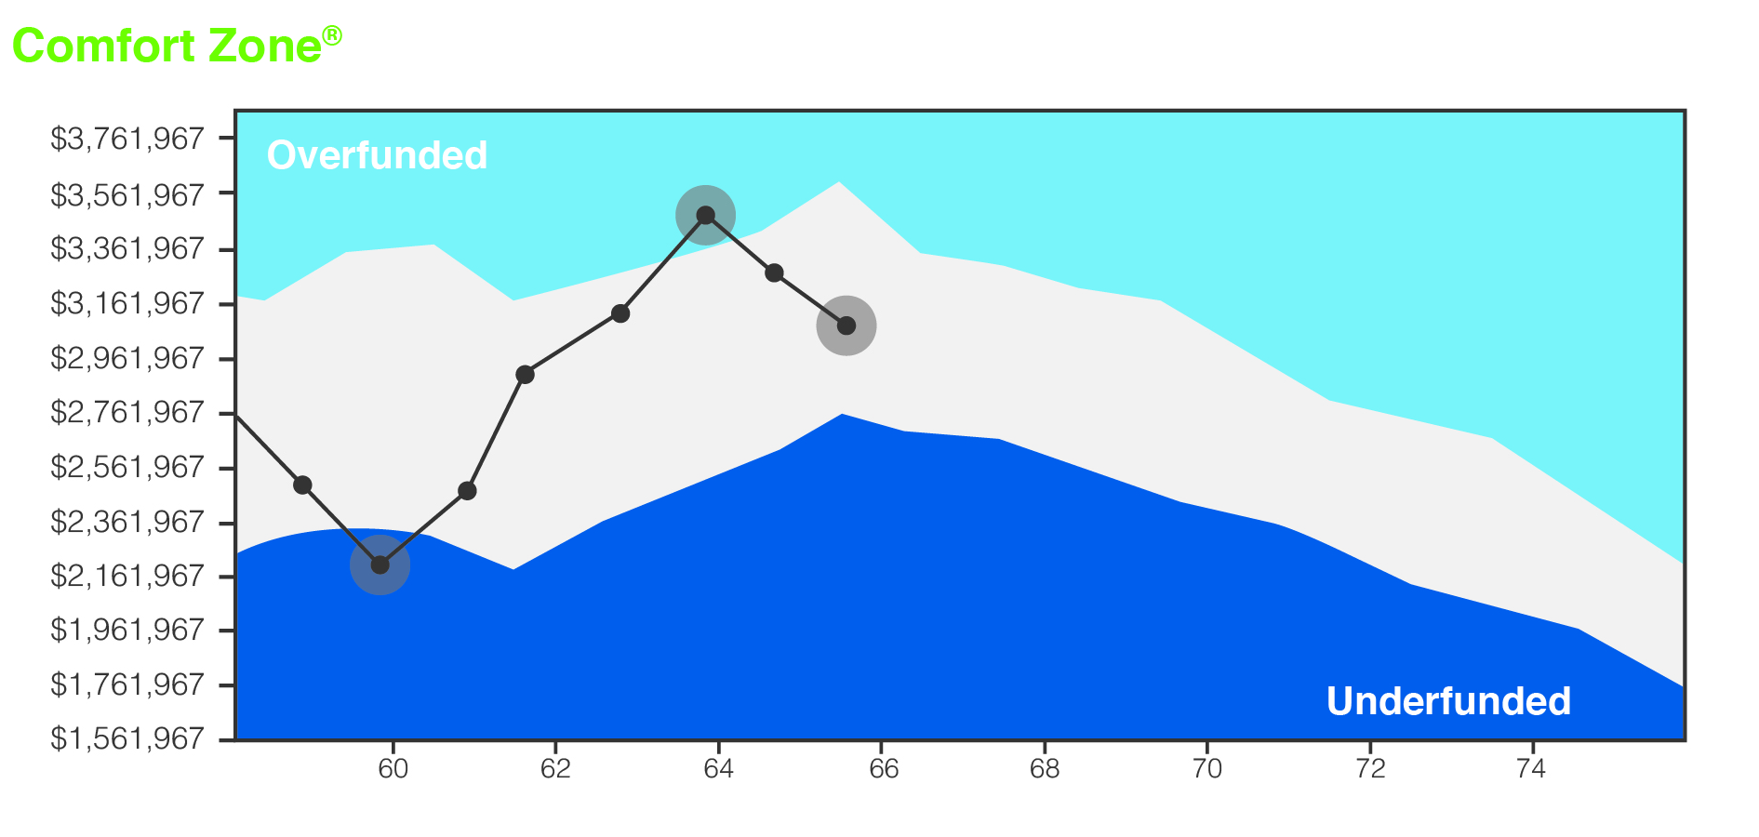
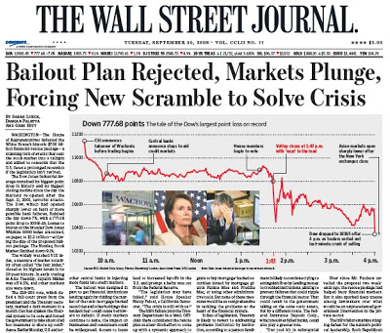
Managing investing behavior & goals through
Comfort Zone monitoring
“Emotion-Driven Investing”
“Goals-Driven Investing”
Elation
Elation
Optimism
Optimism
Optimism
Optimism
Fear
Fear
Notes:
When you put the GDX360 process all together, it encourages better investing behavior. Instead of the common rollercoaster ride where the temptation is to sell out of fear at market lows and to buy out of elation at market highs, the Comfort Zone puts one’s investments within the context of their goals and financial plan. This helps keep emotions in check and focus on the controllable.
Linking your investments to your goals means we are using the only benchmark that matters: the ability to live the life you want today and into the future!
During market lows, the client may drift into the underfunded zone. To return the plan to the Comfort Zone, you may wish to increase the percentage of equities in your portfolio in hope of greater future returns, effectively buying at a relative low. Conversely, the you may drift into the overfunded zone during a market high point. One plan adjustment option is to take some winnings off the table and reduce the percentage of equities in the portfolio. You return to the Comfort Zone and sold equities at a relative high point.

Slide 25
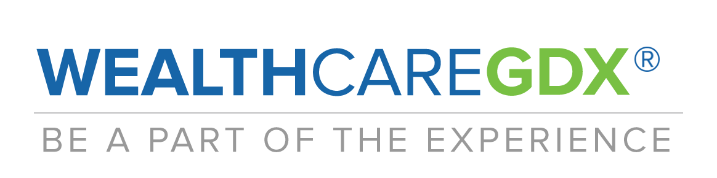

Slide 26
Important Disclosures
©2018 Wealthcare Capital Management LLC and Wealthcare Advisory Partners LLC (collectively, “Wealthcare”) are registered investment advisors with the U.S. Securities and Exchange Commission (SEC) under the Investment Advisors Act of 1940. All Rights Reserved.
This information is provided for educational and informational purposes only and is not to be considered advice. Information is derived from sources which are believed to be reliable, but are not independently audited. Views and opinions are subject to change at any time based on market and other conditions. It is not intended to offer or deliver investment advice in any way. Information regarding investment services is provided solely to gain an understanding of our investment philosophy, our strategies and to be able to contact us for further information.
To better understand the nature and scope of the advisory services and business practices, as well as the AUM breakdown of Wealthcare Capital Management LLC and Wealthcare Advisory Partners LLC, please review our SEC Form ADV Part 2A, which is available by contacting compliance@wealthcarecapital.com. Wealthcare’s GDX360® is a fiduciary process that integrates goals-based planning with investment implementation that includes cost and tax management services designed to put clients first. WealthcareGDX® and GDX360® are trademarks of Wealthcare Capital Management IP LLC.
Examples and concepts used in this presentation are for illustrative, educational purposes and are not a representation or guarantee of specific results for any one specific existing client of Wealthcare or any of its other DBAs. In addition, Wealthcare cannot guarantee any specific financial return results for any client or guarantee a client will in all circumstances of changing personal financial goals and market conditions be able to remain in a client's Wealthcare Comfort Zone®, as that term is illustrated in this presentation. Past performance is not a guide to future performance. Illustrative data used in the presentation regarding market, asset class or other investment returns or other investment statistics on exchange-traded funds and mutual funds, including average investor returns, is from sources believed reliable but not verified independently by Wealthcare.
U.S. Patent Nos. 6,947,904, 7,562,040, 7,650,303, 7,765,138, and 7,991,675

