Slide 1
THE COMFORT ZONE
CERTIFIED WEALTHCARE ADVISOR PROGRAM
Section 1 ▪ Module 2
For Investment Professionals Only

Slide 2
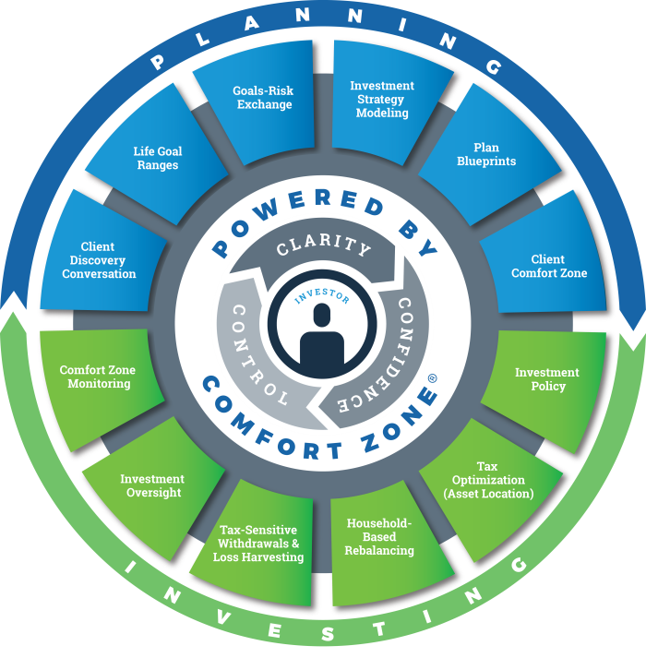
The Comfort Zone
GDX360® is Wealthcare’s experience-based, goals-driven model that aligns your clients money with what matters to them most – their life goals.
Centered on the investor, this process delivers the three elements of a positive financial experience that empower you to make recommend better financial decisions:
Clarity,
Confidence,
and Control

Slide 3
The Comfort Zone
Central to the Wealthcare GDX360 process is the Comfort Zone®, produced by our patented financial planning technology.
The software simultaneously evaluates a client's goals, investment strategy, assets, and all other financial resources (today and in the future), to assess how confident they can be that they’ll meet or exceed their goals. This sophisticated "stress testing" process is a Monte Carlo simulation that simulates 1,000 lifetimes under a variety of market conditions. The plan’s "confidence” or “comfort" is the percentage of the 1,000 simulations (market scenarios) that met or exceeded their goals.
1,000 Lifetimes
1,000 Market Scenarios

Slide 4
The Comfort Zone
Why do we use the Comfort Zone with our clients and why do we recommend a plan whose score will range between 75-90% confidence?

Slide 5
Confidence and Comfort in Balance - Funded
First, let’s look at the returns they might expect to see across the 1,000 simulations:
We generate randomized returns for each year of each simulation that are log-normally distributed and correlated across the asset classes.
These returns are randomized using the mean and standard deviation of each asset class in our capital market assumptions.
Certain trials will include returns that are better (or worse) than actual historical returns.
A comfort score of 75% is consistent with experiencing returns comparable to the worst thirty-year period (1928-1957) in our return history (which starts in 1926.)

Slide 6
Confidence and Comfort in Balance - Funded
Therefore……
a recommendation that falls within the Comfort Zone provides your client with security that they can likely realize their goals even if market performance is extremely poor.
If future market performance is similar to what we’ve experienced historically; their confidence level should increase, possibly resulting in overconfidence or sacrifice.
This allows us to incorporate more higher priority goals into their recommendation in an effort to maintain a result in the Comfort Zone.
Balanced = Comfort

Slide 7
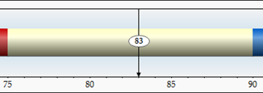
Confidence and Comfort in Balance - Funded
A confidence level between 75% and 90% should give them confidence that their goals can be met or exceeded. This indicates goals are manageable and they can avoid unnecessary investment risk.

Slide 8
Overfunded > 90%.......Scarifice
Next, let’s look at a plan that falls outside the Comfort Zone.
For a plan with a Comfort Score of 95%, you might think…
“That’s great.”
However……….. this is a plan that exceeds its goals in all but the worst 5%
of simulated return scenarios.
That means the plan exceeded its goals for many trials that were far worse than those we have ever experienced. In planning your client's life around results so dire they will likely sacrifice their lifestyle by reducing spending, working longer, or taking unnecessary investment risk.

Slide 9
Overfunded > 90%.......Scarifice
This added confidence may be unnecessarily costly to their lifestyle:
That is, sacrificing too much to protect against a hypothetical catastrophic market downturn.
If planning was a static, “set it and forget it” process, then being so conservative may be warranted.
However, planning should be a dynamic process with advice targeting a more reasonable plan confidence.
Dynamic planning allows for course corrections,
both due to unexpected market returns or changes in their life or goals.

Slide 10
Goal Ranges
Using this dynamic process, we craft a plan within the Comfort Zone and then provide ongoing monitoring. If market performance causes plan comfort score to fall into uncertainty or sacrifice, then adjustments can be made to get the plan back into the Comfort Zone.
This is why we ask you to define both “Ideal” and “Acceptable” levels for each life goal.
These goal ranges give you flexibility when a plan’s comfort score falls outside of the Comfort Zone and adjustments are needed. With regular monitoring, adjustments to advice are often minor and manageable.

Slide 11
Relationship Building
What this means in practical terms…….
You get to initiate a conversation with your clients about whether they would prefer to take less risk, save less retire later or spend more in retirement.
That is a great conversation to have – a real relationship builder. Your client will begin to see that you are more than just an investment consultant.
You are someone who can help them get the most out of life.

Slide 12
Uncertain 74% or Less - Underfunded
Last, let’s look at a plan with a confidence score of 50.
This means that the plan has the same odds as a coin flip. Say you present a recommendation to a client and say…
“Well, there’s a 50/50 chance of achieving your goals”
Would they feel at all confident?
This is why an you as an advisor using the GDX360 process would develop a recommendation within the Comfort Zone . You could confidently say….
“It’s likely you will be able to achieve the plan I’m recommending. I am regularly monitoring your plan and will make adjustments necessary to accommodate for extreme market conditions. Likewise, I encourage you to discuss life or goal changes with me so we can incorporate them into the recommendation.”
Wouldn’t this conversation give you more confidence that the plan being presented is sound?

Slide 13
Underfunded 74% or Less - Underfunded
The most common cause for a Comfort Score dipping below 75% is a…
MARKET DOWNTURN
Market downturns are inevitable. Most advisors consider themselves fortunate if they can say,
“Well, the market lost 25% last year but, due to my investment skills, your portfolio only lost 22%.”
While that is a 3% outperformance of the market, it is little solace to your client. They took a big hit and wonder if they are still OK.
Can they still make it?
What does this mean for their life?
The message they might take from your touting of outperformance is……
“Yeah, you’re hurting and all—but I did great!”

Slide 14
Relationship Building
Our approach is better.
Since we are planning around their goals, we can tell them what the downturn means in the most relevant way: in terms of their life. The conversation might go like this:
“Yes, the market hit a really rough patch and your portfolio was swept up in that tide. But I looked at your plan and we have a few different adjustments we can make to get you back on track.
A couple of years ago when we sat down, you identified your minimum acceptable ranges for several plan goals. Based on those acceptable goals, I have analyzed your plan and have identified a few simple changes that will get you back in the Comfort Zone.
So would you rather work a year longer, save an additional thousand dollars a year or reduce your planned retirement spending by 3%? Any one of those changes will get you back on track.”

Slide 15
Relationship Building
This approach positions you as someone who cares about their life and has a plan to get it back on track. You are not focused on your performance relative to the market but on helping your client remain confident that they are on track to achieve their goals.

Slide 16
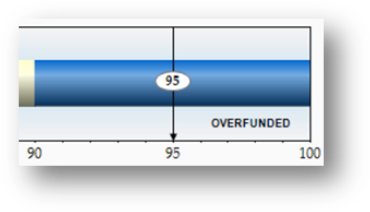
Scarifice 91% or Greater - Overfunded
There is too high of a chance they may not meet or exceed their goals. Adjustments need to be made.

Slide 17
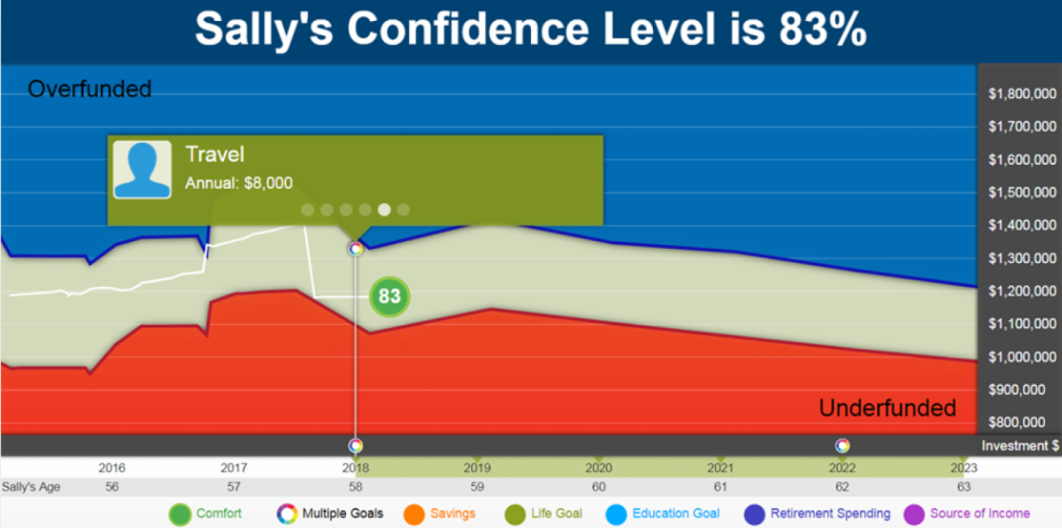
What’s My Comfort Score?
Use our interactive Comfort Zone to track a client's comfort score, review upcoming goals and cash flows and asset ranges.
Ongoing, proactive goal adjustments keep them on track regardless of market movement. Comfort Zone monitoring manages future confidence in achieving life goals while helping avoid excessive risk and lifestyle sacrifice.
This approach transforms the conversations you will have with your clients to focus more on their life and the things that can be controlled rather than market performance and things that are out of your control.

Slide 18
Disclosures
FOR INVESTMENT PROFESSIONALS ONLY
©2018 Wealthcare Capital Management LLC (“Wealthcare”) is a registered investment advisor with the U.S. Securities and Exchange Commission (SEC) under the Investment Advisors Act of 1940. All Rights Reserved.
Wealthcare cannot guarantee a client will in all circumstances of changing personal financial goals and market conditions be able to remain in a client's Wealthcare Plan "Comfort Zone®,” as that term is illustrated in this presentation.
Wealthcare’s GDX360® is a fiduciary process that integrates goals-based planning with investment implementation that includes cost and tax management services designed to put clients first. Comfort Zone ® and GDX360® are trademarks of Wealthcare Capital Management IP LLC, an affiliate of Wealthcare.

