Slide 1
2023 Capital Market Assumptions

Slide 2
Contents
Our Purpose……………………………………………….... 3
Executive Summary……………………………….……… 4
CMA Modeling Framework…………………….…….. 5
Inflation……………………………………………..…………. 8
2023 Core Asset Class Assumptions …………….. 18
Financial Plan Confidence Impact………………… 25
Implementation…………………………………………… 32
Appendix: CMA Detail.……………………………….. 36

Slide 3
Our Purpose
To provide you information regarding
our capital market assumptions framework and process
our 2023 capital market assumptions update
estimated impact on your clients’ financial plans
your transition path forward
So that you are well-positioned to help clients effectively address
investment risk
sequence-of-return risk
In the context of their life goals and financial plan.
Sources for this document include Wealthcare, Bloomberg, CRSP, S&P, Merrill Lynch, HFR, UBS, Callan, BEA, BLS, Blackrock, Voya, J.P. Morgan

Slide 4
Executive Summary
There were no changes to our assumption setting process and frameworks for 2023. We continue to use:
A core/satellite framework for modeling returns and relationships across historical data series.
A two-tier, initial-to-normative framework to manage sequence-of-return risk.
A dual modeling framework informed by history: 1) fundamental approach, 2) risk premium approach.
There were no changes to our inflation assumptions. Our inflation assumption for the next 10 years remains 2.85%. Our inflation assumption for years 11 and beyond remains 2.4%.
There were no changes to our normative return assumptions (years 11+ in the simulation process).
For initial assumptions (1st 10 years of the simulation process), expected returns rose for both stocks and bonds. Large cap stock returns rose from 7.9% to 8.2%. 10-year bond returns rose from 2.9% to 3.5%.
Our assumptions are, on-average, higher for stocks, lower for bonds, and higher for cash relative to our comparator group. Versus BlackRock we are lower for both stocks and bonds by higher for cash.
Impact on financial plans was neutral to slightly positive with conservative portfolios being the most positive.
Transition to the new assumptions begins the weekend of 02/18/2023.
Clients currently on 2021 assumptions will be updated to 2022
Advisors can migrate clients on 2022 assumptions to 2023 over the course of their normal planning cycles this year.

Slide 5
CMA Modeling Framework

Slide 6
Dual Modeling Framework – Normative Conditions
Inflation estimated based on:
Market price for inflation expectations
Fed long-term policy
Long-term experience
Real yields estimated based on:
Long-term experience
Relationship to real growth
Expectations for long-term growth (Fed, productivity, labor force)
Net credit spreads estimated based on:
Long-term credit spread experience
Long-term default-loss experience
Dividend-Buyback yields estimated using:
Long-term earnings yield data
Long-term payout ratio data
Long-term buyback yield experience
Real growth estimated based on long-term growth potential for the U.S. economy.
Net Alpha estimated using Fundamental Law of Active Management
Risk premiums estimated using long-term data & averages

Slide 7
Dual Modeling Framework – Initial Conditions
Initial conditions are observed, or estimated based on observed variables:
Current inflation
Current inflation expectations
Current yields
Nominal GDP
Credit spreads
Div-BB yields
Real growth
Initial expected returns are estimated over a 10 year horizon, beginning with initial conditions and ending with normative conditions:
Real income %
Real growth %
Nominal yields %
Repricing effect –return impact from moving from initial conditions to normative conditions
Risk premiums are adjusted for the repricing effects

Slide 8
Inflation

Slide 9
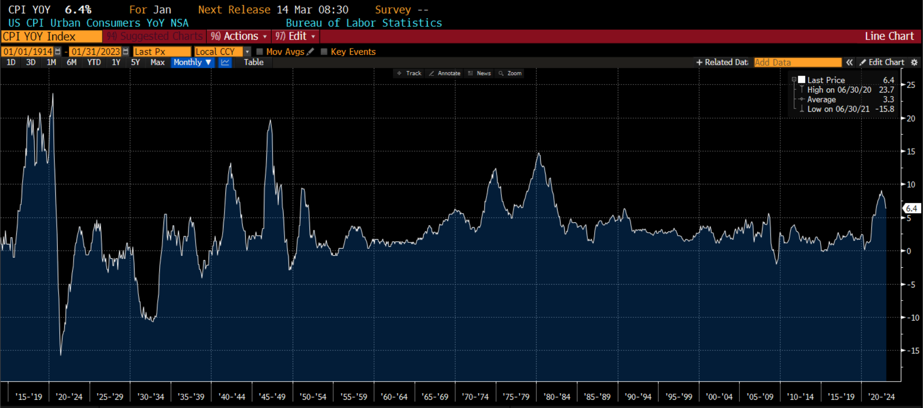
108 Years of Inflation History
Source: Bloomberg
Date Range: 1914-1950
CPI YOY AVG: 2.7%
1950 – 1986
4.3%
1986-2022
2.8%

Slide 10
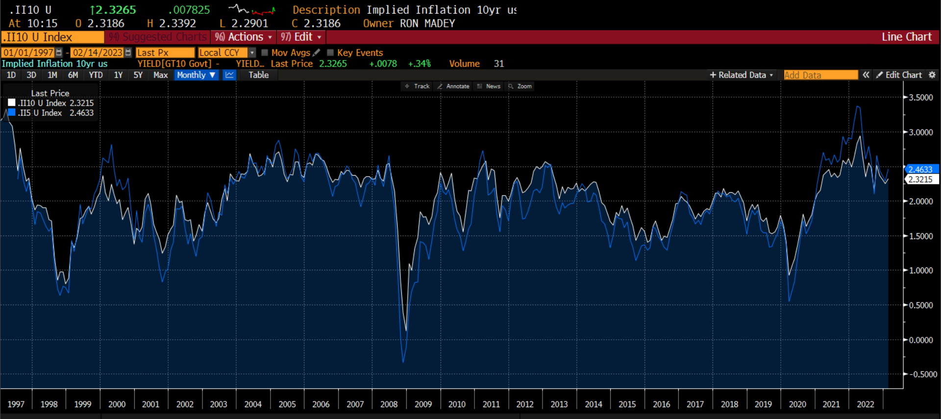
25 Years of TIPS-based Market Implied Inflation Estimates
Market expected average inflation for the next 5 years: 2.47
Market expected average inflation for the next 10 years: 2.32
Market expected average inflation for years 6 thru 10 : 2.17
Source: Bloomberg

Slide 11
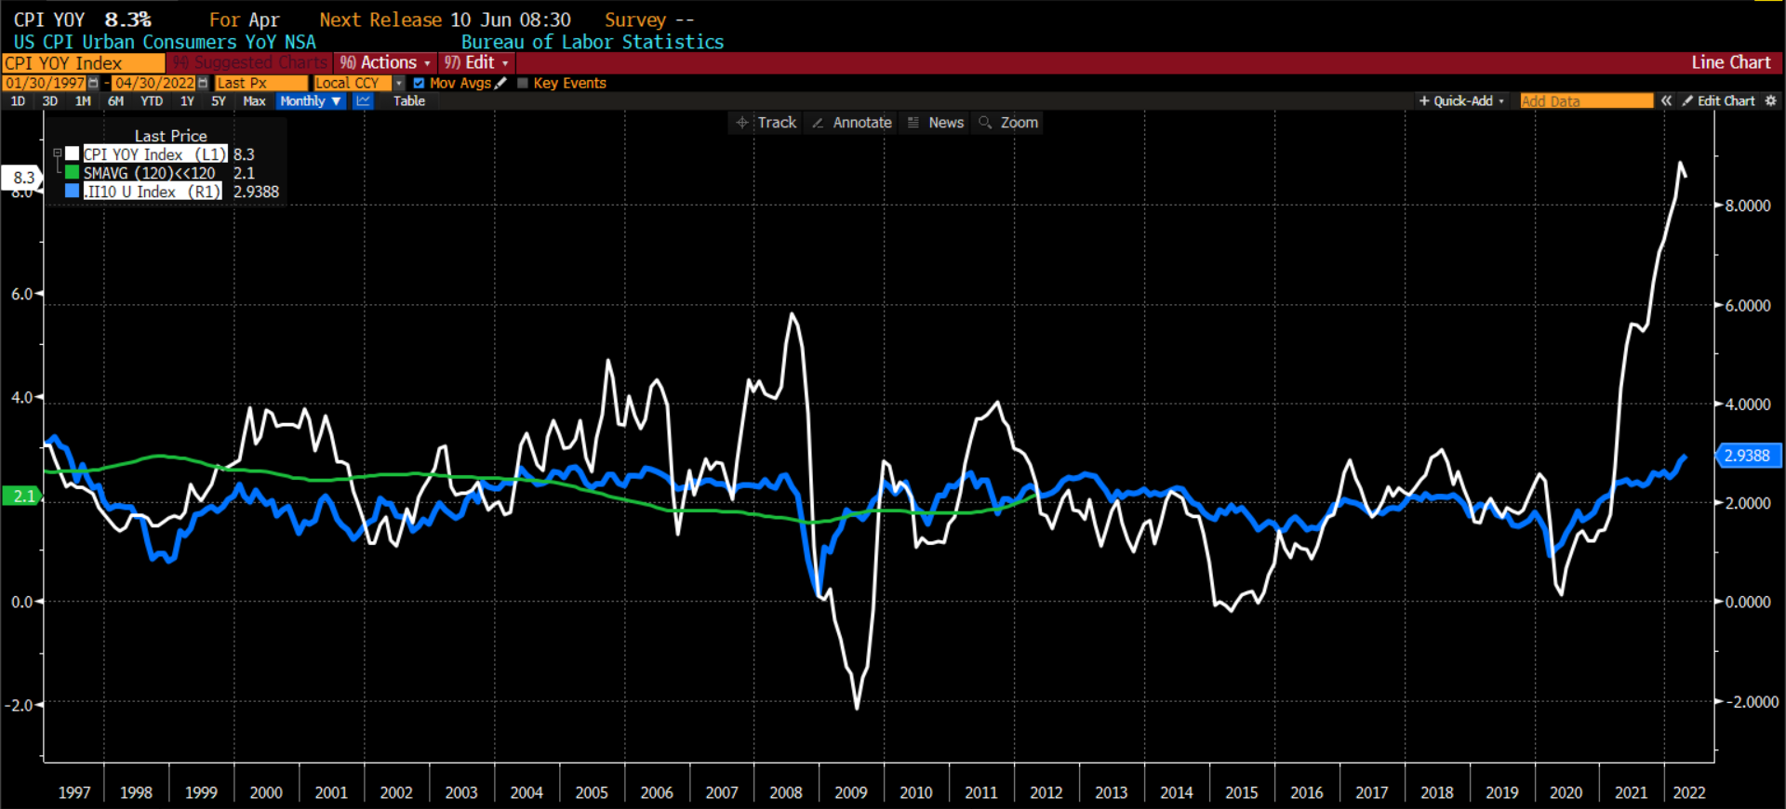
10-Year Implied Inflation vs Actual CPI YOY%
Any time the green line and the blue line touch, the market’s expected inflation exactly equaled the experienced 10-year CPI inflation rate.
Source: Bloomberg

Slide 12
Inflation Assumptions vs Observed Indicators
Inflation Measure (%) | 2022 Observations (as of)
PCE Inflation | 5.0 (Dec)
Core PCE Inflation | 4.4 (Dec)
Fed long-term PCE target | 2.0
Historical average CPI (1922 to 2022) | 3.0%
Historical median CPI Less PCE (1960-2022) | 0.4%
Current CPI Inflation | 6.4 (Jan)
Current Core CPI Inflation | 5.6 (Jan)
Wealthcare initial inflation assumption | 2.85
Wealthcare normative inflation assumption | 2.40
5-year TIPS forecast | 2.47 (Feb)
5-year TIPS forecast, 5 years forward | 2.17 (Feb)
10-year TIPS forecast | 2.32 (Feb)
30-year TIPS forecast | 2.27(Feb)
UMich Survey: 1 year inflation expectations | 4.2 (Jan)
UMich Survey: 5-10 year inflation expectations | 2.9 (Jan)
Source: Bloomberg, Federal Reserve, U.S. Treasury, Bureau of Labor Statistics. Bureau of Economic Analysis, Wealthcare, .

Slide 13
P/E Ratio vs Inflation Regime 50 Years ending December 2020
Table shows average P/E ratios are higher when inflation is lower. So long as inflation remains in the 2.5% to 3.5% range a normative P/E ratio of 20 is more plausible than the long-term average of 17. We are currently 19.5.
Based on TIPS the market continues to price inflation expectations below 3.5%
Source: Bloomberg. Wealthcare

Slide 14
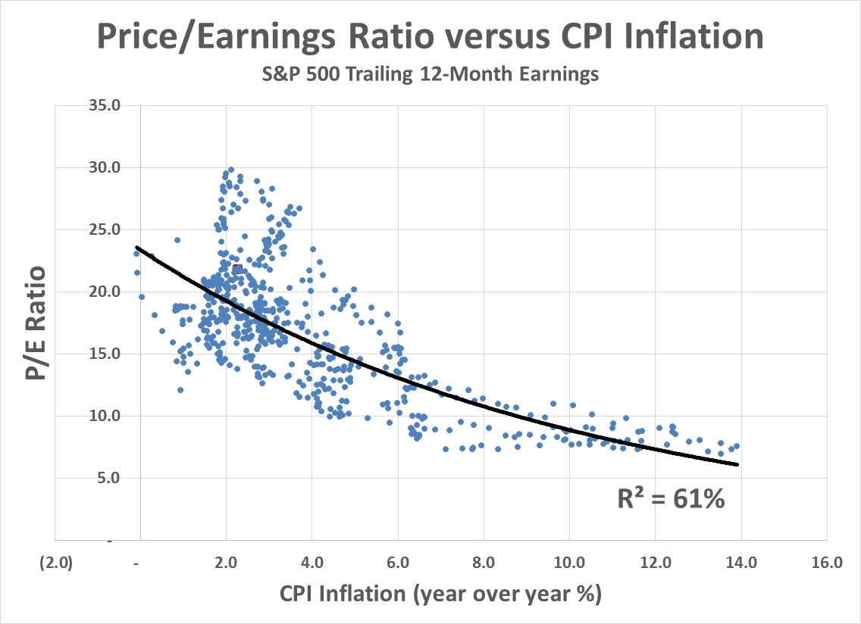
Valuation Historical P/E Versus Inflation
Strong relationship between the level of inflation and fair value P/E

Slide 15
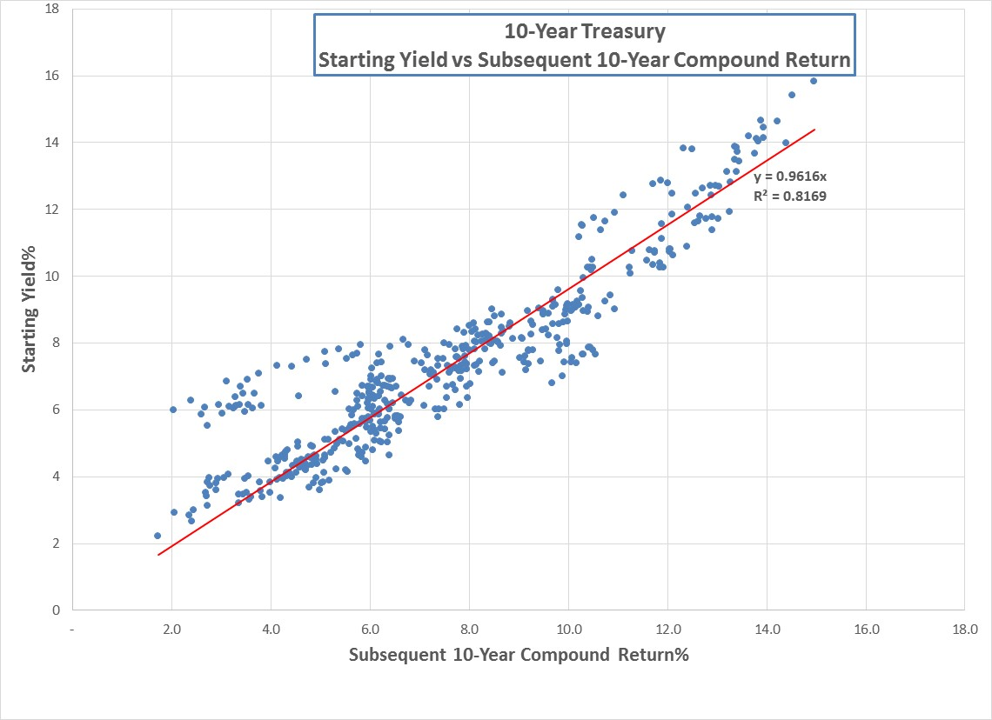
Best Estimate of Expected Return is Yield The yield you buy drives the return you earn

Slide 16
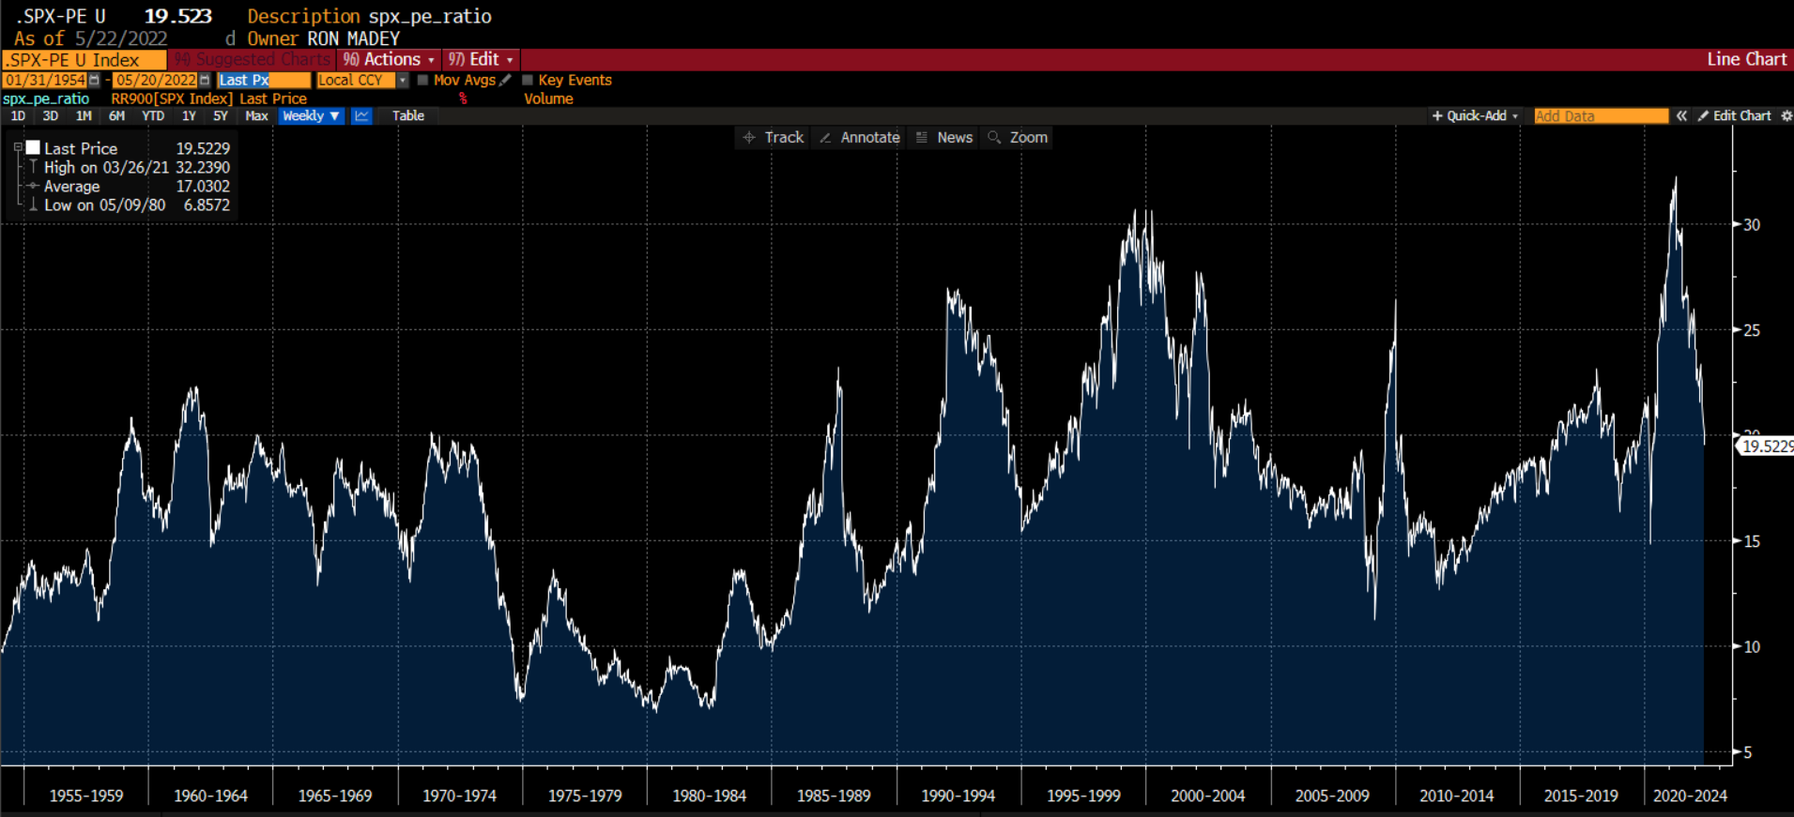
Historical P/E 1954 to 2022
3
4
1
2
Long-Term Average: ~17.0
High Inflation Average: ~9.6
Low inflation average: ~19.5
Today (Feb 14, 2023): ~19.7
Source: Bloomberg. Wealthcare

Slide 17
Inflation Commentary
Real returns drive confidence in your plans
Real returns in the sim engine are generated as nominal returns less inflation
Nominal returns are applied to assets while inflation is applied to cash flows
Not all cash flows grow with inflation.
Spending is typically indexed to inflation
Many fixed income payments (pension benefit, annuities…) are not.
Retiree plans can be more negatively impacted by rising inflation
If you change the initial default inflation, or specify cash flow inflation different than the default, you will change the real returns modeled in your plan as nominal returns in the system don’t change with your inflation adjustment. Raising inflation lowers real returns and confidence, and vice versa
Last year we estimated that, on average across all plans, a 0.25% decrease in initial default inflation increases confidence by 1.8 confidence points

Slide 18
2023 Asset Assumptions

Slide 19
Wealthcare’s Core Return Assumptions
 |  | 2022 |  |  |  | 2023 |  |  |  | Change
 | Initial | Normative | 50 Year Blend |  | Initial | Normative | 50 Year Blend |  | Initial | Normative | 50 Year Blend
Nominal
Large Cap | 7.9 | 9.2 | 8.9 |  | 8.1 | 9.2 | 8.9 |  | 0.2 | 0.0 | 0.0
10-Year | 2.9 | 4.6 | 4.3 |  | 3.5 | 4.6 | 4.4 |  | 0.6 | 0.0 | 0.1
Cash | 2.5 | 3.3 | 3.1 |  | 3.5 | 3.3 | 3.3 |  | 1.0 | 0.0 | 0.2
Inflation | 2.9 | 2.4 | 2.5 |  | 2.9 | 2.4 | 2.5 |  | 0.0 | 0.0 | 0.0
Real
Large Cap | 5.0 | 6.8 | 6.4 |  | 5.2 | 6.8 | 6.4 |  | 0.2 | 0.0 | 0.0
10-Year | 0.0 | 2.2 | 1.8 |  | 0.7 | 2.2 | 1.9 |  | 0.6 | 0.0 | 0.1
Cash | -0.4 | 0.9 | 0.6 |  | 0.7 | 0.9 | 0.9 |  | 1.0 | 0.0 | 0.2
Normative: No changes.
Initial: Inflation unchanged. Nominal returns higher. Real returns higher.
Higher returns tend to lead to higher confidence, everything else being equal.
Source: Wealthcare

Slide 20
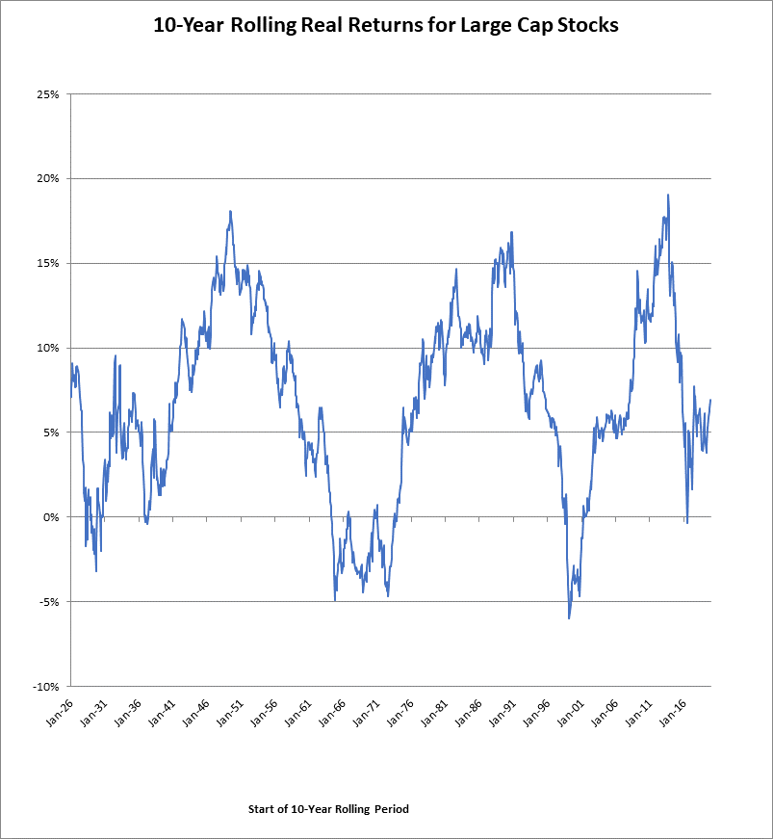
Real Equity Returns 10-Year Rolling Periods
Equal Weight Rolling Period Median: 6.78%
Full period real compound return is 6.62%
Our normative real return assumption is effectively 6.75%

Slide 21
Wealthcare’s 2023 Core Risk Assumptions
 | Initial 2022 | Initial 2023 | Normative 2022 & 2023
Large Cap Stocks | 15.9 | 17.6 | 17.6
10-Year Treasury | 5.4 | 5.9 | 6.5
Cash | 1.4 | 1.6 | 1.6
Initial risks have risen modestly due to higher and more volatile inflation regime and are now near or equal to the Normative risk values.
Higher risk will tend to reduce confidence, all other things being equal.

Slide 22
Wealthcare’s 2023 Core Correlation Assumptions
2022 Initial Conditions
2023 Initial Conditions
 | Large Cap | 10-Year | Cash
Large Cap | +1.00 | -20.00 | -0.02
10-Year | -20.00 | +1.00 | +0.23
Cash | -0.02 | +0.23 | +1.00
 | Large Cap | 10-Year | Cash
Large Cap | +1.00 | 0.00 | -0.02
10-Year | 0.00 | +1.00 | +0.23
Cash | -0.02 | +0.23 | +1.00
Initial correlations have risen modestly due to higher and more volatile inflation regime and are now equal to the Normative correlation values.
Higher correlations will tend to reduce confidence, all other things being equal.

Slide 23
Comparator Analysis Ten Year Horizon*
2023 thru 2032 | JPM 10/21/2021 | Voya 11/23/2022 | Callan 12/31/2022 | Blackrock 12/06/2022 |  | Average | Average ex Voya |  | WC Next 10 11/30/2022 |  | Wealthcare less Blackrock
Large Cap | 7.9 | 4.8 | 7.3 | 8.8 |  | 7.2 | 8.0 |  | 8.1 |  | (0.7)
Agg Bonds | 4.6 | 4.0 | 4.3 | 4.2 |  | 4.3 | 4.4 |  | 3.9 |  | (0.3)
Cash | 2.4 | 2.3 | 2.8 | 3.3 |  | 2.7 | 2.8 |  | 3.5 |  | 0.2
Blackrock assumptions, using a 12/06/2022 valuation date, are reasonably close to ours. We are lower on the equities and bonds but higher for cash
Voya is an outlier on equities.
We are very close the average-ex-voya for stocks, lower for bonds and higher for cash

Slide 24
Sequence of Return Tests: Initial vs Normative
We tested plan confidence drift over 10 years for initial and normative assumptions
The lowest third of history, measured by 10-year real returns, shows the following drift experience, starting from 83%, before plan adjustments:
The evidence shows that:
Naïve forecasts are superior to Normative forecasts, improving plan confidence drift by 11 points and therefore reducing required plan adjustments
Inflation forecasting is the most difficult. More work is needed here
Naïve forecasts for stocks and bonds are efficacious
CMA Test | Ending Confidence | Change from 83%
Normative Forecasts | 38 | - 45
Naïve Forecasts (S/B/I) | 49 | - 34
Perfect I, Naïve S/B | 79 | - 04

Slide 25
Financial Plan Confidence Impact

Slide 26
Confidence Level Impact Testing Average Impact (2022 CMA ➔ 2023 CMA)

Slide 27
Confidence Level Impact Testing Range of Impact (2022 CMA ➔ 2023 CMA)

Slide 28
Confidence Level Impact Testing: Distribution of Impact (2022 CMA➔2023 CMA)

Slide 29
Confidence Level Impact Testing: Cumulative Distribution of Impact (2022 CMA ➔2023 CMA)
~98% of plans fall between -1 and +4% confidence impact

Slide 30
Confidence Level Impact Testing: Distribution of Impact (2021 CMA ➔ 2022 & 2023 CMAs)
Clients on 2021 CMAs are better served to move directly to 2023 CMAs

Slide 31
Clients on 2021 CMA are Better Off Moving Directly to 2023 CMA Advisors need to adopt 2023 Quickly to Gain the Benefit

Slide 32
Implementation

Slide 33
Path Forward
Target implementation date is the weekend February 18th.
You will control adoption of 2023 CMA for existing clients as you meet over the next year
New clients will get the 2022 assumptions
Existing clients that are not on 2022 assumptions by Feb 18th will be updated to 2022 assumptions and you will control when to adopt 2023 assumptions.
Training on CMA swapping within GDX360 will be provided
Questions/comments/insights/feedback? Please contact us

Slide 34
Thank You!

Slide 35
DISCLOSURES
For investment professionals only – not for distribution Wealthcare Capital Management LLC is a registered investment advisors with the U.S. Securities and Exchange Commission (SEC) under the Investment Advisors Act of 1940. All Rights Reserved. Content in this presentation is derived from generally available information and is believed to be reliable, but has not been independently verified by Wealthcare. The information is of a general nature and should not be construed as investment advice. Information contained in this presentation is as of a point in time and subject to change with market and other conditions. Examples and concepts used in this presentation are for illustrative, educational purposes and are not a representation or guarantee of specific results for any one specific existing client of Wealthcare. In addition, Wealthcare cannot guarantee any specific financial return results for any client or guarantee a client will in all circumstances of changing personal financial goals and market conditions be able to remain in a client's Wealthcare Plan "Comfort Zone®,” as that term is illustrated in this presentation Past performance is not a guide to future returns. Investing involves risks including possible loss of principal. No investment strategy or risk management technique can guarantee return or eliminate risk in all market environments. U.S. Treasuries may be considered “safe haven” investments but do carry some degree of risk including interest rate, credit, and market risk. They are guaranteed by the U.S. government as to the timely payment of principal and interest and, if held to maturity, offer a fixed rate of return and fixed principal value. The performance results reflect historical asset allocation and manager changes at the model level after 2002. Prior to 2002 model returns were calculated using index benchmarks. The Russell 3000 index was used to proxy Domestic Equities, MSCI ACWI ex US was utilized to proxy foreign stocks, and the Bloomberg 7-10 Year Treasury Index for fixed income. The performance of Three (3) Month T-bills has been used to represent the returns of cash equivalents. Model performance does not reflect actual account performance for any specific client or a composite performance for a group of clients. Model results represent what an investor’s returns might have been, had they been invested in the exact investments using the exact same allocation for the exact same time period for the model portfolio reflected. This model performance was calculated on a total return basis. It includes the reinvestment of dividends and capital gain distributions. Model performance is displayed gross of advisory fees and net of expense ratios. Model performance does not include the effects of brokerage commissions, other trading related market impact costs, and platform fees. All indexes are unmanaged and cannot be invested into directly. Unmanaged index returns do not reflect fees, expenses, or sales charges. Index performance is not indicative of the performance of any investment. Illustrative data used in the presentation regarding market, asset class or other investment returns or other investment statistics on exchange-traded funds and mutual funds, is from sources believed reliable but not verified independently by Wealthcare Capital Management. Wealthcare’s GDX360® is a fiduciary process that integrates goals-based planning with investment implementation that includes cost and tax management services designed to put clients first. GDX360® is a trademark of Wealthcare Capital Management IP LLC, an affiliate of Wealthcare.

Slide 36
CMA Detail

Slide 37
Wealthcare’s 2023 Capital Market Assumptions Fixed Income Nominal Returns Assumptions
 | Initial | Normative | 50 Year Blend
10 year Govt Bond | 3.5% | 4.6% | 4.4%
7-10 year Govt Bond | 3.5% | 4.6% | 4.3%
TIPS | 3.9% | 4.5% | 4.4%
Aggregate Bonds | 3.9% | 4.8% | 4.6%
Intermed. Govt/ Corp | 3.6% | 4.7% | 4.5%
High Yield Bonds | 5.5% | 6.2% | 6.1%
Cash | 3.5% | 3.3% | 3.3%
Munis | 3.0% | 4.0% | 3.8%
High Yield Munis | 4.1% | 4.8% | 4.7%

Slide 38
Wealthcare’s 2023 Capital Market Assumptions Domestic Equity Nominal Return Assumptions
 | Initial | Normative | 50 Year Blend
Large Cap Equities | 8.1% | 9.2% | 8.9%
Large Cap Value | 8.6% | 9.7% | 9.5%
Large Cap Growth | 7.4% | 8.4% | 8.2%
Mid Cap | 9.2% | 10.5% | 10.2%
Mid Cap Value | 9.8% | 10.9% | 10.7%
Mid Cap Growth | 8.3% | 9.8% | 9.5%
Small/Mid Cap Equities | 9.3% | 10.6% | 10.4%
Small Cap | 9.4% | 10.7% | 10.5%
Small Cap Value | 10.6% | 11.6% | 11.4%
Small Cap Growth | 7.9% | 9.4% | 9.1%
Total Domestic Equity | 8.5% | 9.6% | 9.4%

Slide 39
Wealthcare’s 2023 Capital Market Assumptions Nominal Returns Assumptions for Foreign Equities, Real Assets, and Alternatives
 | Initial | Normative | 50 Year Blend
Foreign Equity | 8.5% | 9.6% | 9.4%
International Equity | 8.1% | 9.1% | 8.9%
Emerging Market Equity | 8.7% | 9.9% | 9.7%
REITs | 7.2% | 8.2% | 8.0%
Commodities | 4.4% | 4.1% | 4.1%
Hedge Funds | 6.3% | 6.1% | 6.2%
Private Equity | 10.2% | 11.4% | 11.1%

