Slide 1
Wealthcare Overview

Slide 2
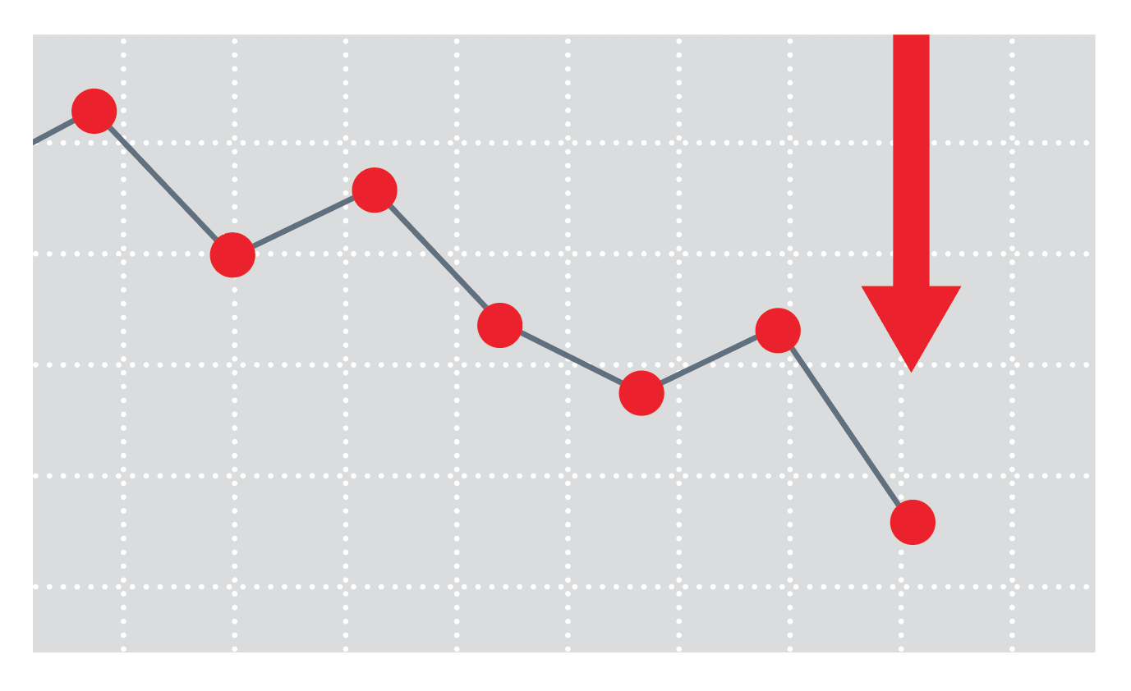
Meet Steve
Meet Steve
Adverse Trends Transforming Steve’s Industry
Fiduciary (SEC) rulings
“Even if blocked at the eleventh hour, the rule’s spirit will live on.” –Bloomberg
New tech savvy & “on-demand” client demographic
“Consumers have changed in both what they value and what they are willing to pay for.” –Financial Advisor Magazine
Fee Compression
“Though a lot of clients and prospects are asking about fees, what they're actually willing to pay comes down to the adviser's value proposition beyond investments.” –InvestmentNews
Robo-Squeeze
“Estimates for the future Robo-Advisory market predict between $2.2 trillion and $3.7 trillion in assets to be managed with the support of Robo-Advisory services in 2020. By the year 2025, this figure is expected to rise to over $16 trillion AUM.”
– Deloitte Consulting
Solo Practitioner Extinction
"As advisors of the baby boomer generation age, more of them are looking to bring on a successor. This is spawning multi-advisor offices, since those advisors must bring on their successors long before they transition out of their jobs.” –Financial Advisor Magazine
Notes:
Department of Labor (DOL) rulings: shift to Fiduciary standard. Fee transparency
Robo-Advisor: the ability to get asset allocation at a low cost without the need for an advisor. Advisors need to provide value outside of investments.

Slide 3
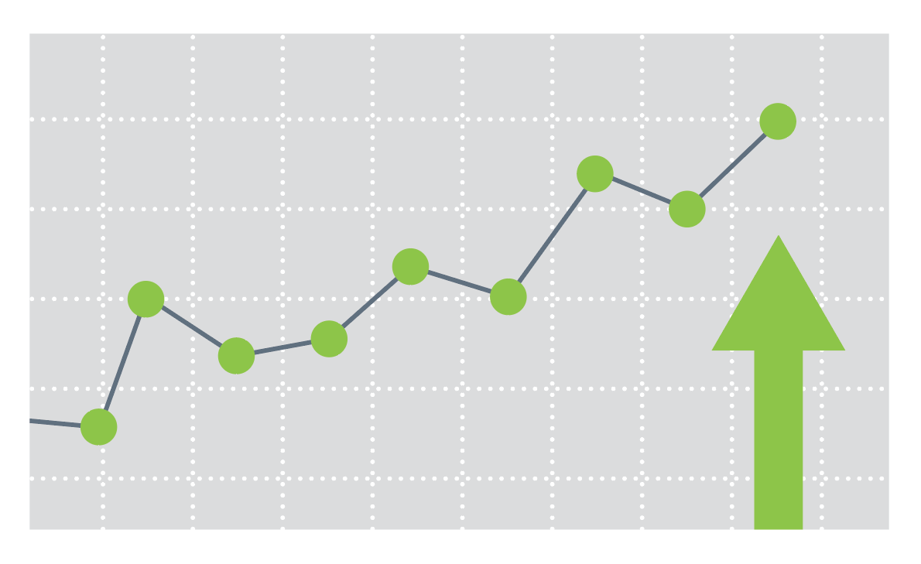
Meet Steve
Trend Toward Personalized Experiences
The Rise of Goals-Driven Investing
“Goals-based wealth management is likely to become the industry norm across more wealth tiers.” –Deloitte Consulting
Creating a Better Experience
“More and more, an advisor’s differentiation and value will be tied to the overall client experience, and to being an effective behavioral coach who helps people execute their plans.” –PriceWaterhouseCoopers
Clients Expect a Personalized Approach
“Today’s investors expect a unique, customized experience and holistic goal oriented advice, requiring advisors to be specialized, flexible, agile and digitally enabled.” –Accenture
Riding the Digital Wave
“By encouraging customers to share their consumption data, companies can enable the outcomes different demographics want, creating highly personalized value. This leads to greater customer engagement and loyalty, and via goals-based video games, new customer relationships.” –PwC
Innovation Drives Experiences
“Investor demands and regulations are encouraging new business models in the wealth management industry that focus on providing better customer experiences and value add.” - Capgemini

Slide 4
Financial advisor technology landscape
FINANCIAL PLANNING
PORTFOLIO ACCOUNTING
CRM
RISK PROFILING
DOCUMENT MANAGEMENT
INVESTMENT MGMT / AUTOMATION
DATA AGGREGATION / COLLECTION
ANALYTICS

Slide 5
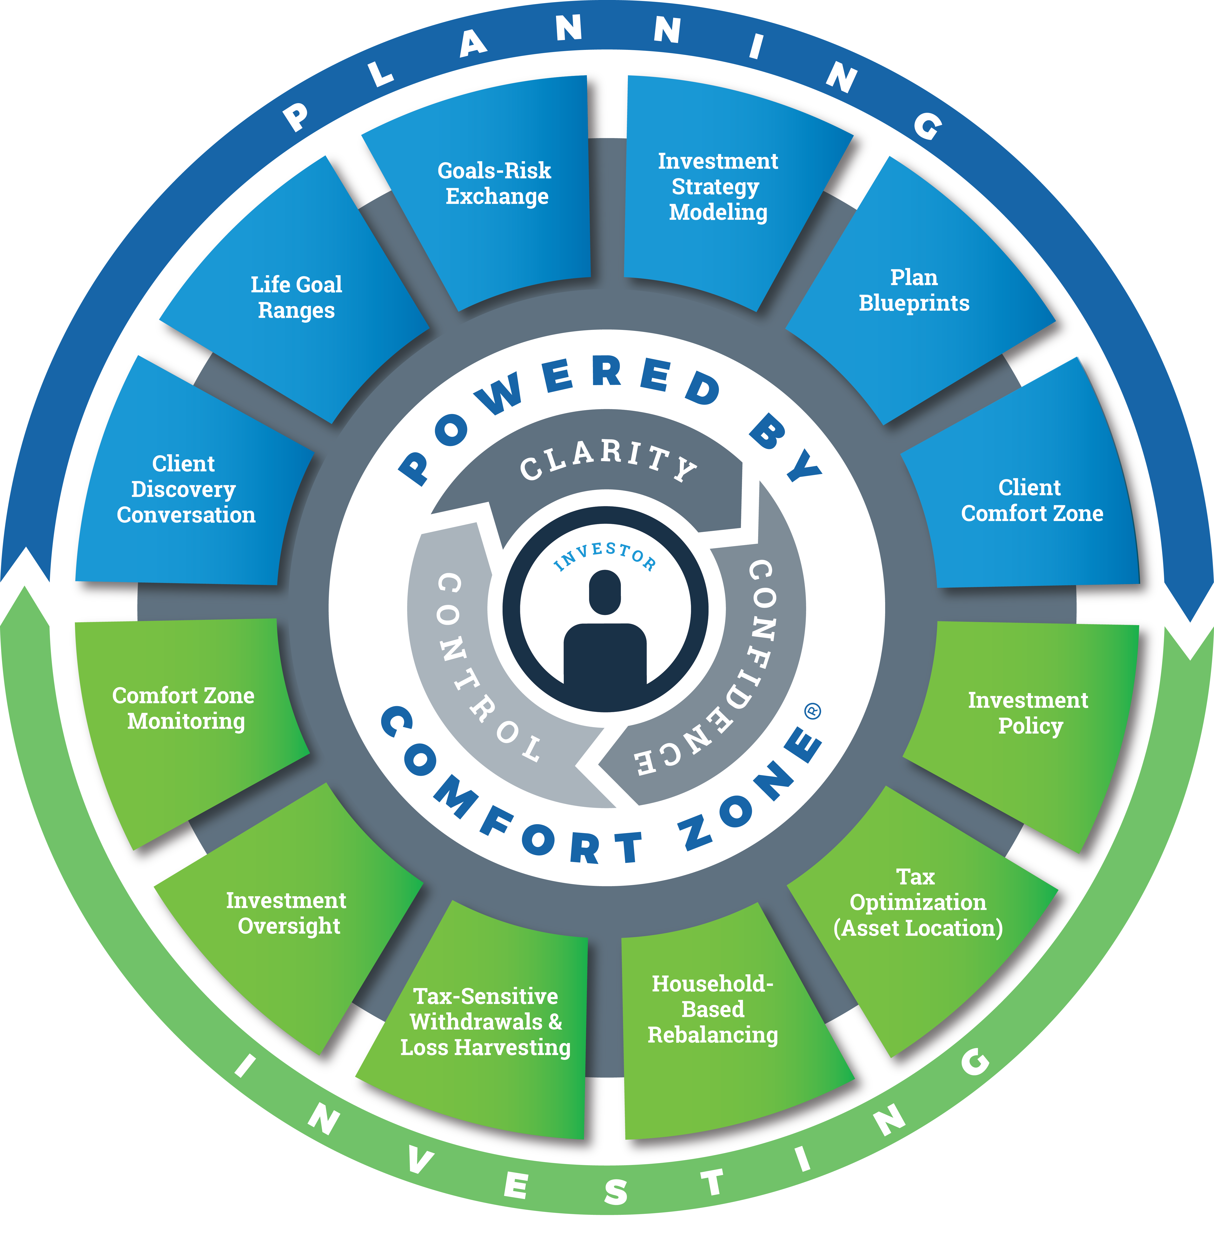
Our Technology
Our technology
Planning
Planning Platform
Risk Profiling
Data Aggregation
Simulation Engine
Goals Management
Document Management
Client Relationship Management
Investing
Investment Mgmt/Automation
Portfolio Accounting
Trading/Rebalancing
Fiduciary Compliance
Investment Policy Statements
Household-Based Portfolio Mgmt
Asset Location (Tax Management)
Tax Loss Harvesting
Model Management

Slide 6
Technology & workflow simplified
A WAY OF SERVING CLIENTS
PLATFORM & RESOURCES
Custody & Clearing
Paperless Office Suite
Advisor Traded
Portfolios
Client Workflow Interface
Trust Services
Centrally Managed Advisory
Insurance & Annuities
Retirement Plan Business

Slide 7
Technology & workflow diversified
A WAY OF SERVING CLIENTS
PLATFORM & RESOURCES¹
Custody & Clearing
Paperless Office Suite
Advisor Traded
Portfolios
Client Workflow Interface
Trust Services
Centrally Managed Advisory
Insurance & Annuities
Retirement Plan Business
¹ Service offerings may vary by custodian.

Slide 8
Where’s Your Dot?

Slide 9
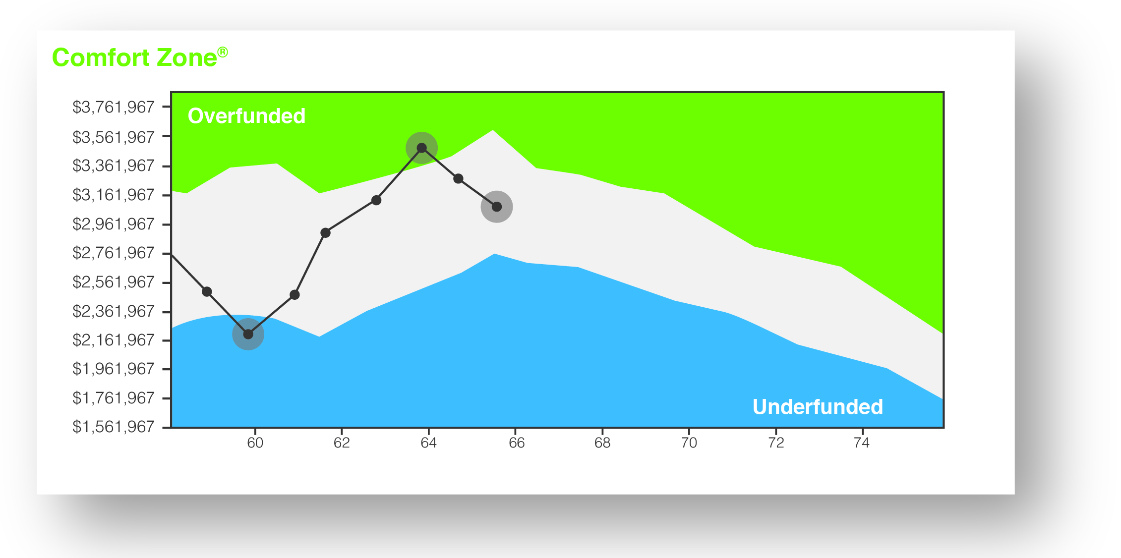
Where’s your dot?
Return
Risk

Slide 10
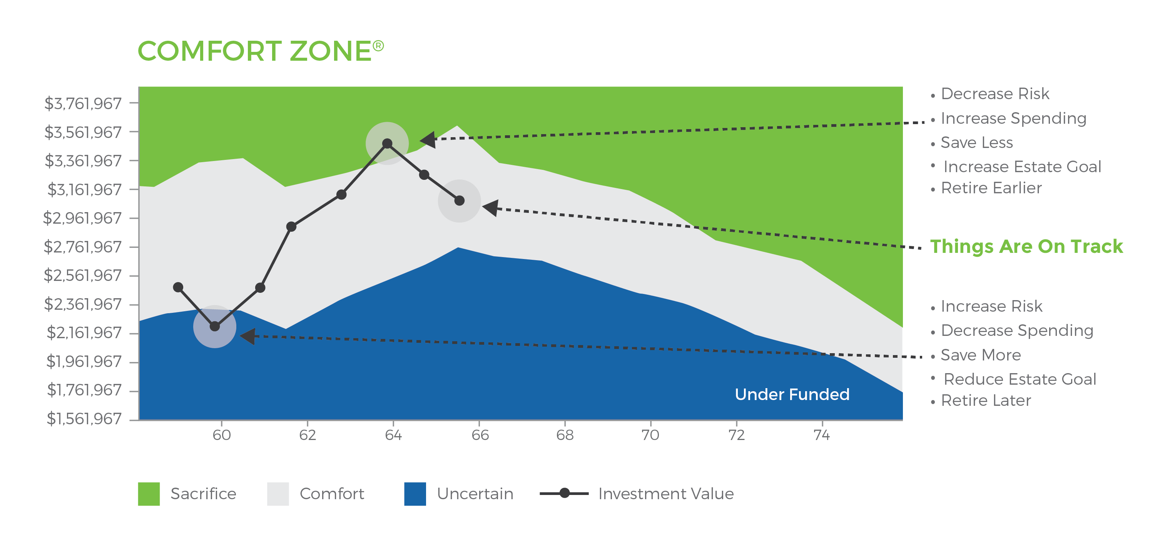
The center of the client experience
Comfort Zone® enables advisors to visually demonstrate a client’s financial positioning in relation to achieving their goals. Clients gain a clear, relevant picture of their financial health over time.

Slide 11
Who we are
A Look Inside
Corporate offices in Richmond, VA and West Chester, PA
28 corporate employees
Professional designations: CFA®, CFP®, ChFC®, CASL®, CPA, AIFA®, RPA
Full back office support: marketing, operations, trading, planning, billing, and compliance
Numerous custodian options including Fidelity, Pershing, LPL, Schwab & TD
Investment framework with 40 programs & 400 portfolios
Over $2B combined Assets Under Management across both RIAs
12 patents registered

Slide 12
Introducing the Wealthcare Experience to Clients (Advisor Name/Title)

Slide 13
Simple process combining life goals and investing

Slide 14
Meet Alex and Amy
CLIENT EXAMPLE
Both 58 years old
One son, 19 years old
Combined income: $395,000
Love to travel
Priorities:
Reduce amount saved annually (to travel more now)
Educate son through graduate school
Retirement spending
Retirement travel budget (Cayman Islands!)
Current Assets:
Joint
Taxable account: $1,300,000
Alex
IRA $800,000
Roth IRA $25,000
Amy
IRA $300,000
Note: Your age, asset size, and goals may be different. Your financial plan will be customized to fit your life.

Slide 15
Proper planning requires the proper approach
Life Planning
Financial Planning
Investment Planning
What’s your story?
What are your values and beliefs?
What do you want to accomplish with the rest of your life?
What lifestyle do you want now and in the future?
Examine current and future resources available to satisfy the needs of your life plan.
Determine the best way to invest your current and future resources to accomplish your life plan.
Construct a portfolio that will give you a higher probability of achieving your goals.

Slide 16
The WEALTHCAREGDX® approach
Wealthcare’s goals-driven planning approach allows you to live well AND invest well.
Shows how to make smart tradeoffs among your different, and often competing goals and priorities
Provides confidence in achieving your financial needs and aspirations
Avoids undue sacrifice to your lifestyle and unnecessary investment risk
Life Planning
Financial Planning
Investment Planning
It’s YOU-driven, not market-driven.

Slide 17
Goals are not data points
Think of each goal as a range between Ideal and Acceptable. Ideal represents your greatest aspiration. Acceptable, a lesser but still satisfying result.
 | Ideal | Acceptable
Retirement Age Goal: | Both Retire Now | Both Retire at 65
Retirement Spending Goal: | $175,000 | $160,000
Risk Tolerance Goal: | -5% Annual Downside | -14% Annual Downside
Estate Goal: | $2,000,000 | $100,000
Annual Saving Goal: | Reduce by $10,000 | Increase by $15,000
Education for Son: | MBA | Undergraduate
Cayman Islands Travel: | $25,000 | $10,000

Slide 18
How does stress testing work?
Central to our goals-based approach is the Comfort Zone® confidence calculation
This analysis simultaneously evaluates your goals, your investment allocation, and your assets to determine how confident you can be that you will exceed your goals.
Wealthcare’s approach subjects your goals and investments strategy to a sophisticated “stress testing” process which simulates 1,000 market environments, both good and bad. Your confidence (comfort) is the percentage of the 1,000 simulations that exceed your goals.
For example, if you exceeded your goals in 830 of 1,000 tests, your confidence level is 83%. Said another way, there would be an 83% probability that the goals of your financial plan would not only be met, but would be exceeded.

Slide 19
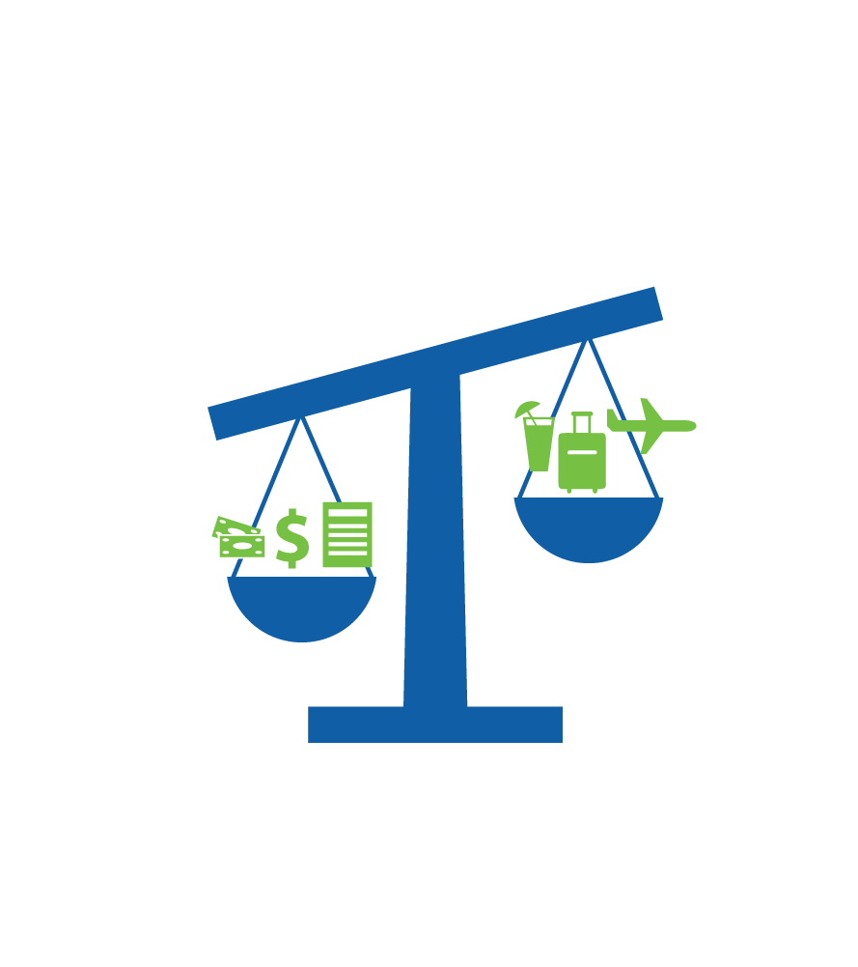
Stress testing for sacrifice
Overfunded > 90%...Sacrifice
You are needlessly sacrificing your lifestyle. You could take less investment risk, achieve larger or more goals sooner and still maintain confidence in your financial future.

Slide 20
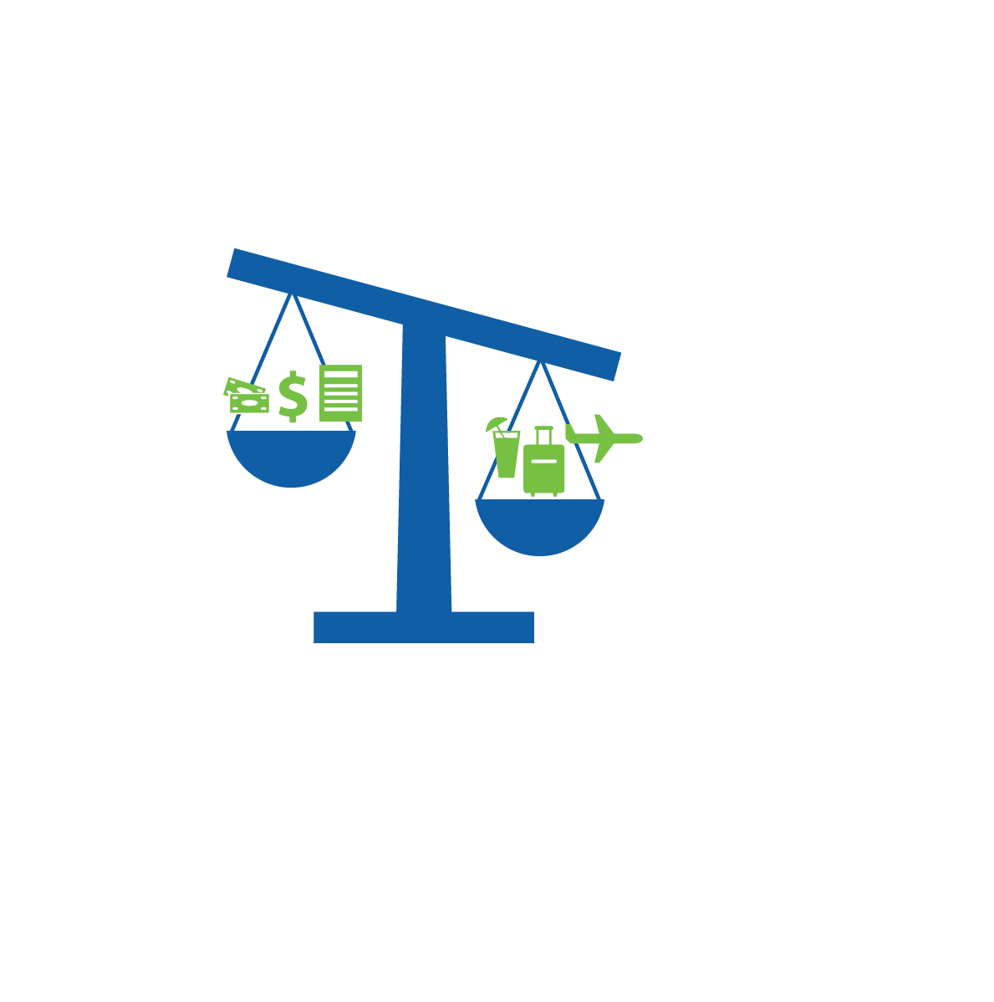
Stress testing for uncertainty
Underfunded < 75%...Uncertain
There is too high of a chance you may not exceed your goals. Adjustments need to be made.

Slide 21
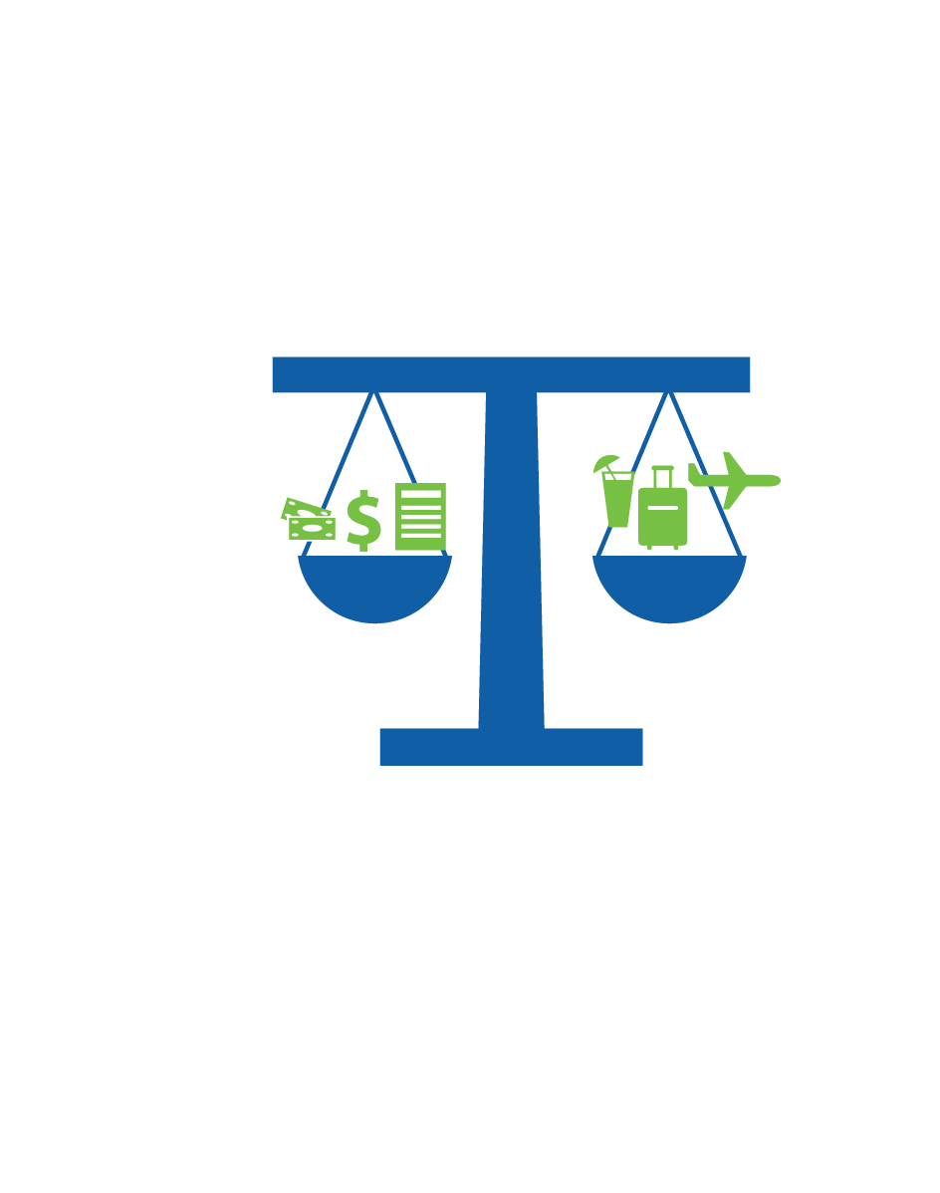
Stress testing to find balance
Confidence and Comfort in Balance - Funded
A confidence level between 75% and 90% should give you confidence that you can exceed your goals. This reading indicates a set of goals that is manageable and avoids unnecessary investment risk and/or sacrifice.

Slide 22
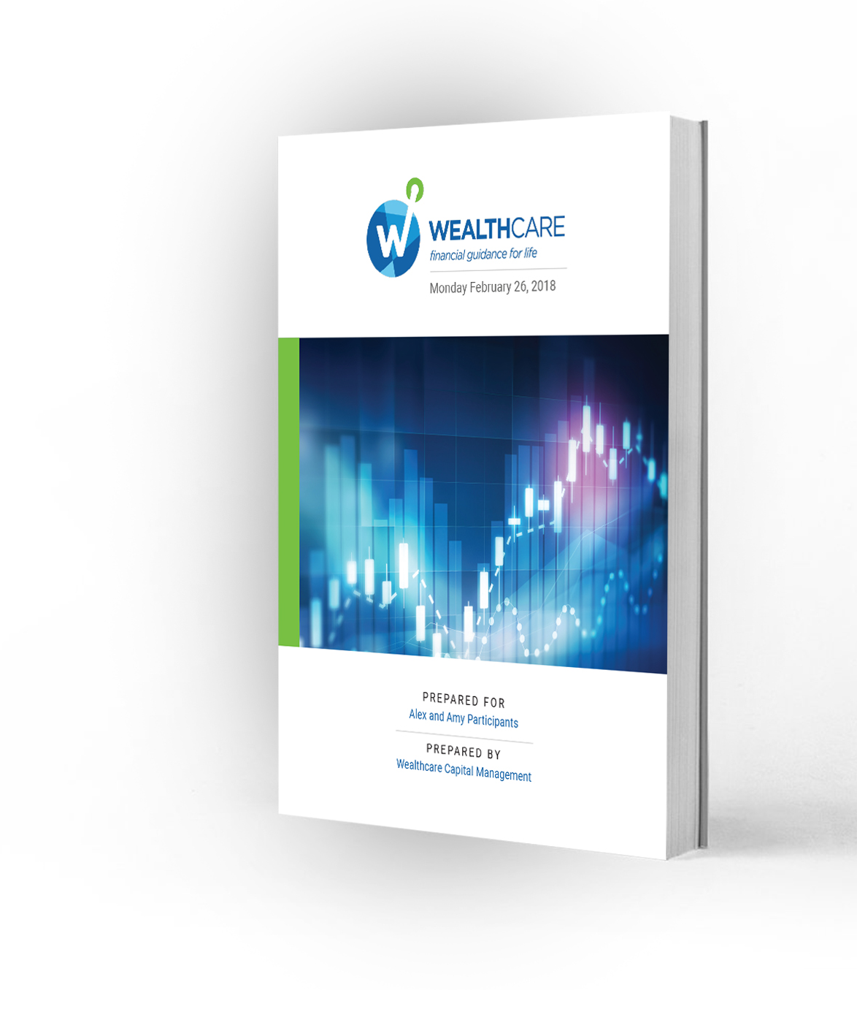
Sample client recommendation
 | Ideal | Recommended | Acceptable
Retirement Age: | Both Retire Now | Both Retire at 62 | Both Retire at 65
Retirement Spending: | $175,000 | $175,000 | $160,000
Risk Tolerance: | -5% Annual Downside | -6% Annual Downside | -14% Annual Downside
Estate: | $2,000,000 | $500,000 | $100,000
Education: | MBA | MBA | Undergraduate
Annual Saving: | -$15,000 | -$10,000 | +$10,000
Cayman Travel: | $25,000 | $25,000 | $10,000
Comfort Level: 4% 83% 99%

Slide 23
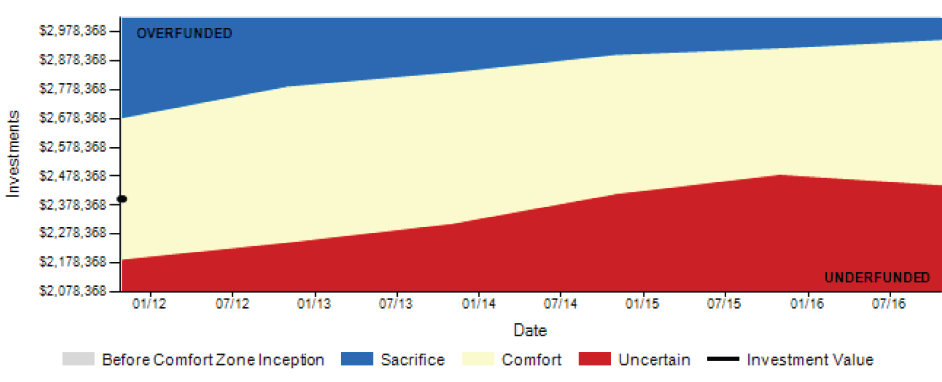
Monitoring progress toward goals
Wealthcare’s GDX360® Status Reports can be automatically generated every quarter.
Your plan dynamically links your lifestyle goals with your investments.
You are free from uncertainty about what to do when confronted by change, expected or otherwise.
COMFORT ZONE (SHORT TERM)
Your Wealthcare plan will evolve as your life does, proactively adapting to life’s changes along with you.

Slide 24
Knowing what to do…and when
The Comfort Zone® acts as an “early warning system” notifying you if you need to make adjustments
COMFORT ZONE (SHORT TERM)

Slide 25
Simple process combining life goals and investing

Slide 26
Traditional account based portfolio management
Typical scenario: advisor sets an investment allocation based on a series of risk profile answers.
“My goal for this investment is to grow (aggressively, moderately or cautiously).
“My income sources are _________ (stable/unstable).”
“I plan to start taking money from my investments in _____ years.”
Current Assets (4 accounts):
JOINT: Taxable Acct $1,300,000
ALEX: IRA $800,000
Roth IRA $25,000
AMY: IRA $300,000
65/35
Risk
Allocation

Slide 27
Pitfalls of account-based portfolio management
Account-based shortcomings:
Costs
Larger number of holdings at inception (4 x 12= 48 transactions)
More positions equals more costs
Taxes
Putting tax inefficient holdings in taxable accounts
Treasuries, REITs, High Yield FI, Commodities, belong in Tax- Deferred accounts
Rebalancing
Each account rebalanced seperately
Greatly increases transaction costs
Rebalancing in taxable account creates a tax consequence
48 Total Holdings
Joint
12 Funds
65/35
Risk
Allocation
12 Funds
12 Funds
Treasuries, Commodities, REITS, High Yield
12 Funds

Slide 28
Controlling the controllable
Wealthcare invests differently
Two guiding principles drive our investment philosophy:
Cost Effective: Managing cost through Household-Based Portfolio Management
Goals Connected: Managing your investing behavior & goals through Comfort Zone monitoring
For over a decade, we have helped investors pursue and strive to achieve their goals using a dynamic and disciplined approach that seamlessly integrates your financial plan with your investments.

Slide 29
Non-traditional advisor alpha– Morningstar¹ gamma
.
APPROACH | VALUE ADDED (BPS)
Total Wealth Framework | 38
Dynamic Withdrawals | 54
Asset Location/Withdrawal Sourcing | 52
Total | 144
¹Blanchett, Kaplan. August 2013. “Alpha, Beta and Now…Gamma” Journal of Retirement.

Slide 30
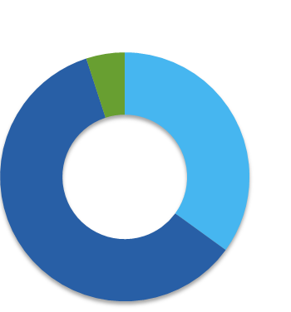
Managing portfolios at the household level
5% Cash
Efficient Portfolio Construction
Asset location tax management strategies
Household-based rebalancing
Smart withdrawal sourcing
Other tax management services
30% FI
$1.3M
$800k
$25k
65/35
Plan
Allocation
$300k
65% Equity

Slide 31
Asset location — tax management strategies
5% Cash
Place high turnover holdings in tax-deferred/exempt accounts FIRST to maximize after-tax wealth
Put low turnover holdings in taxable accounts FIRST to take advantage of more favorable long-term capital gains rates
Place high-yielding holdings in tax-deferred accounts
Put muni bonds in taxable accounts and taxable bonds in tax-deferred accounts
65/35
Plan
Allocation
30% FI
65% Equity
Active Equities, Treasuries, REITs, Commodities
Passive Equities, Muni Bonds
IRA
IRA
Joint
100% Equities
Roth

Slide 32
Household-based trading & rebalancing
5% Cash
Fewer positions at inception; lower trading costs
Use a single tax-deferred/exempt account to rebalance entire portfolio
Rebalance using fewer positions, resulting in fewer trades & lower costs
Minimize tax impact of rebalancing by not using a taxable account
65/35
Plan
Allocation
30% FI
65% Equity
Infrequent rebalancing minimizes tax consequence
Primary rebalancing account
12
Funds
6
Funds
Half the funds & half the transaction costs
IRA
Joint
2 Funds
4 Funds
IRA

Slide 33
Smart withdrawal strategies
Sample $145K withdrawal. Done in a tax-efficient manner based on the assets and circumstances of each individual household.
 |  |  |  |  |  | Typical |  | Wealthcare
Household |  |  | MV($) | % | Unrealized Gains | Trades | Tax Effect ($) | Trades | Tax Effect ($)
Domestic Equity (VTI) |  |  | 1,355,575 | 56%
International Equity (VEU) |  |  | 220,675 | 9%
Fixed Income (IEF) |  |  | 800,250 | 33%
Cash |  |  | 48,500 | 2%
 |  |  | 2,425,000 | 100%
Tax Deferred (IRAs)
Domestic Equity (VTI) |  |  | 246,907 |  |  |  |  | (72,500)
International Equity (VEU) |  |  | 220,675
Fixed Income (IEF) |  |  | 609,513 |  |  |  |  | 72,500
Cash |  |  | 22,906
Tax Exempt (Roth)
Domestic Equity (VTI) |  |  | 25,000
Taxable Account
Domestic Equity (VTI) |  |  | 1,083,668 |  | 671,874 | (72,500) | (8,990) |  | 0
International Equity (VEU) |  |  | 0 |  | 0
Fixed Income (MUB) |  |  | 190,737 |  | 15,137 | (72,500) | (1,151) | (145,000) | (2,301)
Cash |  |  | 25,594 |  | 0
 |  |  |  |  |  |  | (10,141)¹ |  | (2,301)¹
 |  |  |  |  |  |  | -0.42% |  | -0.09%
¹Note: tax effect calculated by applying 20% tax rate on realized gains

Slide 34
Other tax management strategies
5% Cash
Monitor timing of when unrealized gains or losses change from short-term to long-term
Tax-loss harvesting services
Consider unrealized status of positions and carry forward losses prior to trading of taxable accounts
65/35
Plan
Allocation
30% FI
65% Equity
Recognize Unrealized Losses
Gain
-$3k
Joint
Gain
Gain

Slide 35
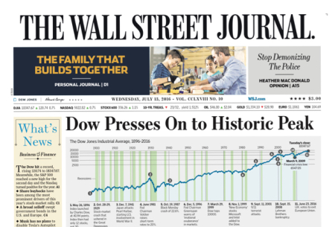
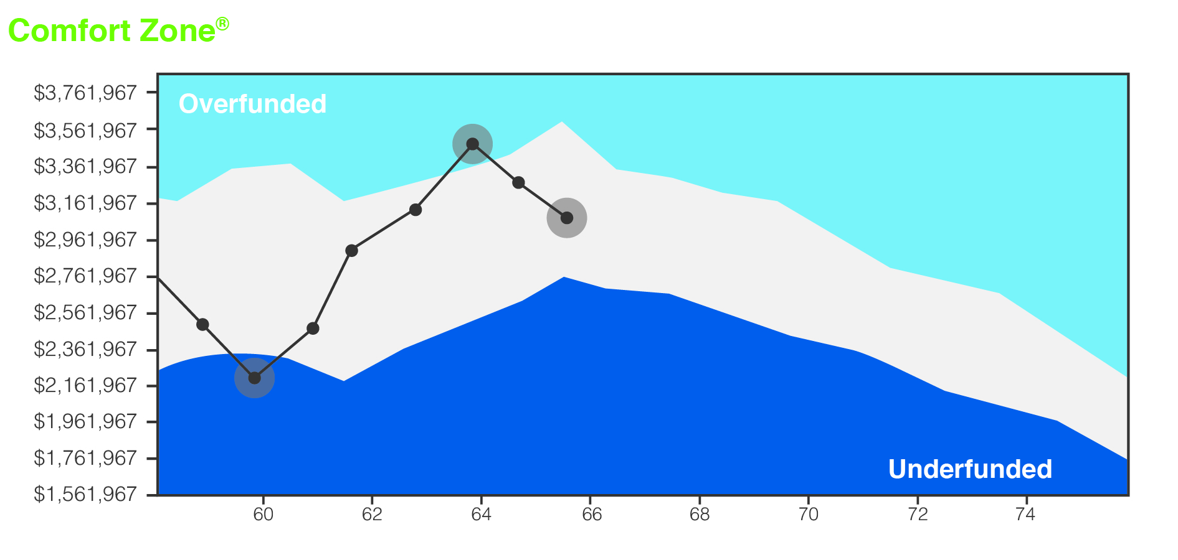
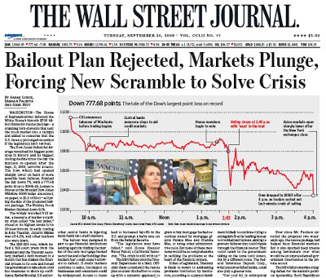
Managing investing behavior & goals through Comfort Zone monitoring
“Emotion-Driven Investing”
“Goals-Driven Investing”
Elation
Elation
Optimism
Optimism
Optimism
Optimism
Fear
Fear

Slide 37
Important Disclosures
©2018 Wealthcare Capital Management LLC and Wealthcare Advisory Partners LLC (collectively, “Wealthcare”) are registered investment advisors with the U.S. Securities and Exchange Commission (SEC) under the Investment Advisors Act of 1940. All Rights Reserved.
This information is provided for educational and informational purposes only and is not to be considered advice. Information is derived from sources which are believed to be reliable, but are not independently audited. Views and opinions are subject to change at any time based on market and other conditions. It is not intended to offer or deliver investment advice in any way. Information regarding investment services is provided solely to gain an understanding of our investment philosophy, our strategies and to be able to contact us for further information.
To better understand the nature and scope of the advisory services and business practices, as well as the AUM breakdown of Wealthcare Capital Management LLC and Wealthcare Advisory Partners LLC, please review our SEC Form ADV Part 2A, which is available by contacting compliance@wealthcarecapital.com. Wealthcare’s GDX360® is a fiduciary process that integrates goals-based planning with investment implementation that includes cost and tax management services designed to put clients first. WealthcareGDX® and GDX360® are trademarks of Wealthcare Capital Management IP LLC.
Examples and concepts used in this presentation are for illustrative, educational purposes and are not a representation or guarantee of specific results for any one specific existing client of Wealthcare or any of its other DBAs. In addition, Wealthcare cannot guarantee any specific financial return results for any client or guarantee a client will in all circumstances of changing personal financial goals and market conditions be able to remain in a client's Wealthcare Comfort Zone®, as that term is illustrated in this presentation. Past performance is not a guide to future performance. Illustrative data used in the presentation regarding market, asset class or other investment returns or other investment statistics on exchange-traded funds and mutual funds, including average investor returns, is from sources believed reliable but not verified independently by Wealthcare.
U.S. Patent Nos. 6,947,904, 7,562,040, 7,650,303, 7,765,138, and 7,991,675

